Slide 1

Projects in
Burgula Grampanchayat
by
www.pragathiwelfaresociety.com

Slide 2

INTRODUCTION –
BURGULA GRAMPANCHAYAT
Burgula in Farooqnagar Mandal, Mahabubnagar District, Telangana State, India is headed by a Sarpanch
There are three villages and seven tribal areas
Burgula
Kasireddyguda
Nerella Cheruvu
Kadiyalakunta thanda
Thimmajipally thanda
Pothurajugadda thanda
Muchoniguda thanda
Devunigundu thanda
Kundelukunta thanda
Nallamettala thanda
www.pragathiwelfaresociety.com

Slide 3
BURGULA GRAMPANCHAYAT (CONTD.)
Population: Approximately five thousand
Occupation: Agriculture – including paddy (rice), corn, jowar and some vegetables production
One small-scale cotton industry employs 20 villagers
Most people work on daily wages
One high school, one upper primary school and six primary schools with a strength of 900 students
Some children walk about 2–3 kilometers to the school
www.pragathiwelfaresociety.com

Slide 4
MISSION & VISION
Poverty alleviation through
  Education improvement
  Women empowerment
  Youth development
  Preventive health care
  Community participation
www.pragathiwelfaresociety.com

Slide 5
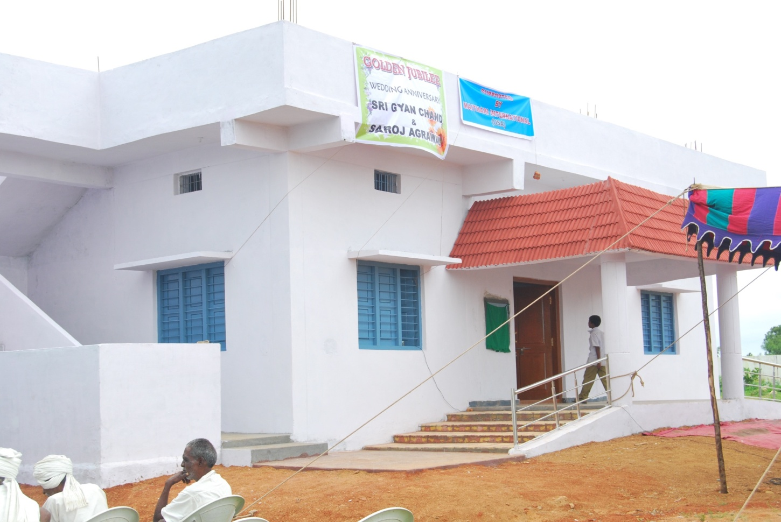
EDUCATION IMPROVEMENT
Mini-auditorium construction
www.pragathiwelfaresociety.com

Slide 6
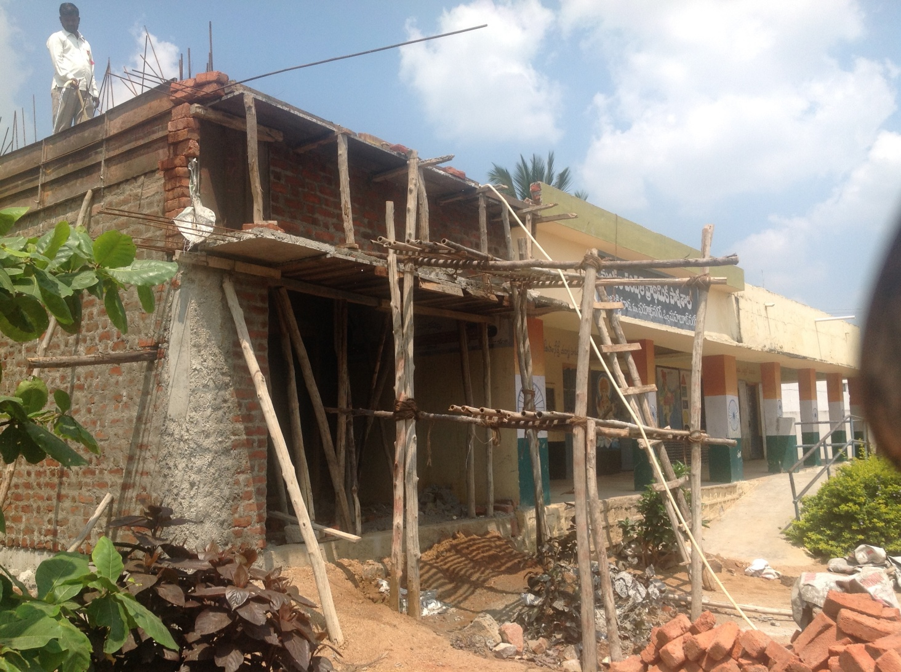
EDUCATION IMPROVEMENT
Classrooms construction
www.pragathiwelfaresociety.com

Slide 7
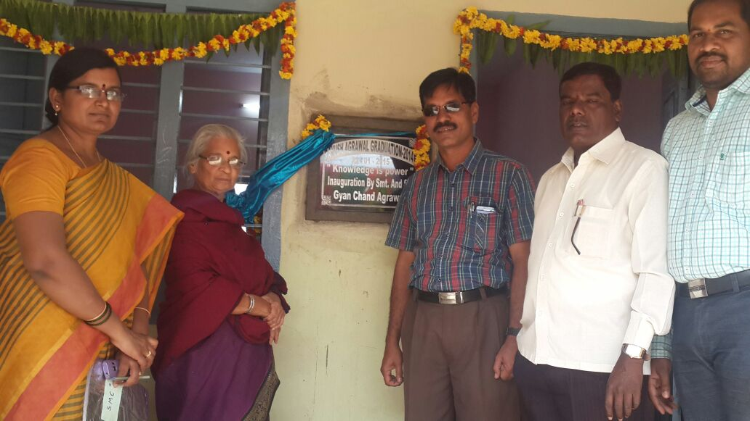
EDUCATION IMPROVEMENT
New classrooms construction in schools
www.pragathiwelfaresociety.com

Slide 8
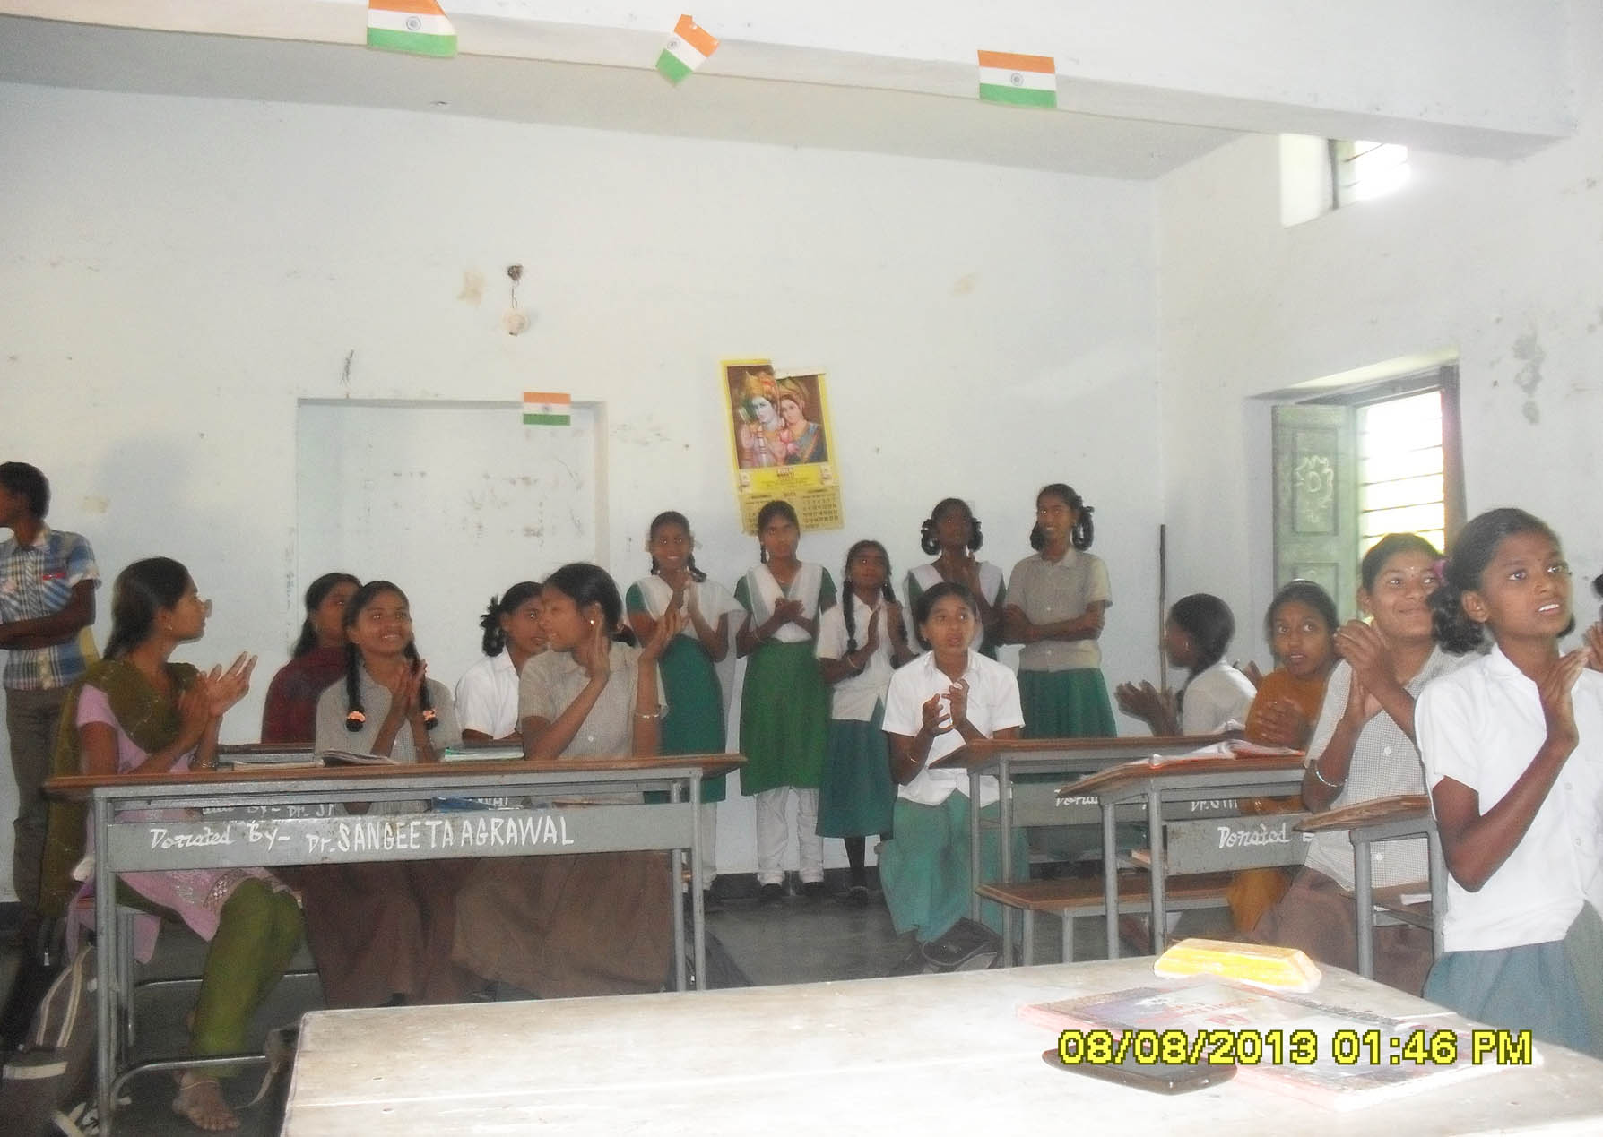
EDUCATION IMPROVEMENT
Most of the students sat on the floor in the schools.
Over time we have provided about 150 desks and benches.
www.pragathiwelfaresociety.com

Slide 9
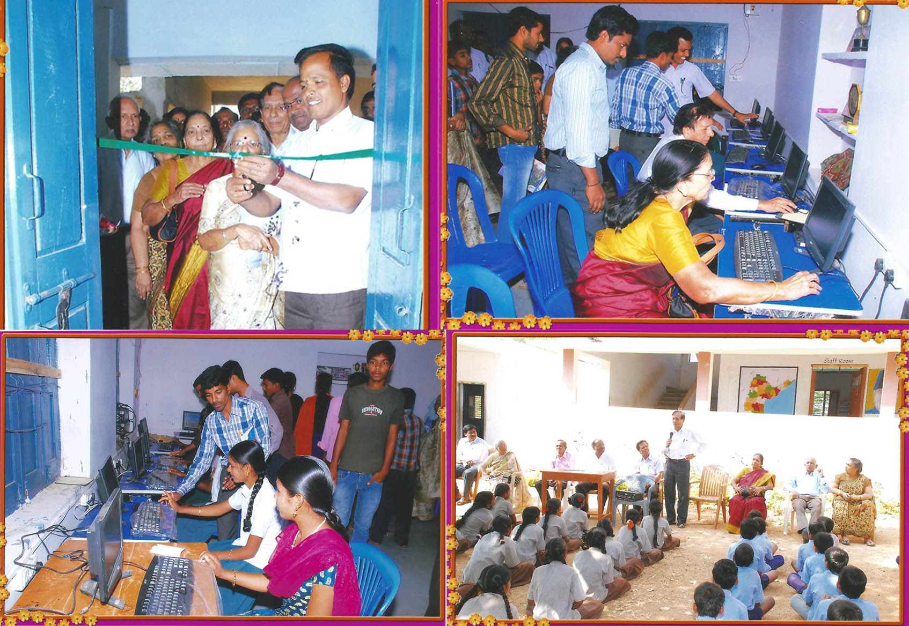
EDUCATION IMPROVEMENT
Computer literacy program
Remodeling of computer room and repairing of computers
Now there are 40 computers in the village
www.pragathiwelfaresociety.com

Slide 10
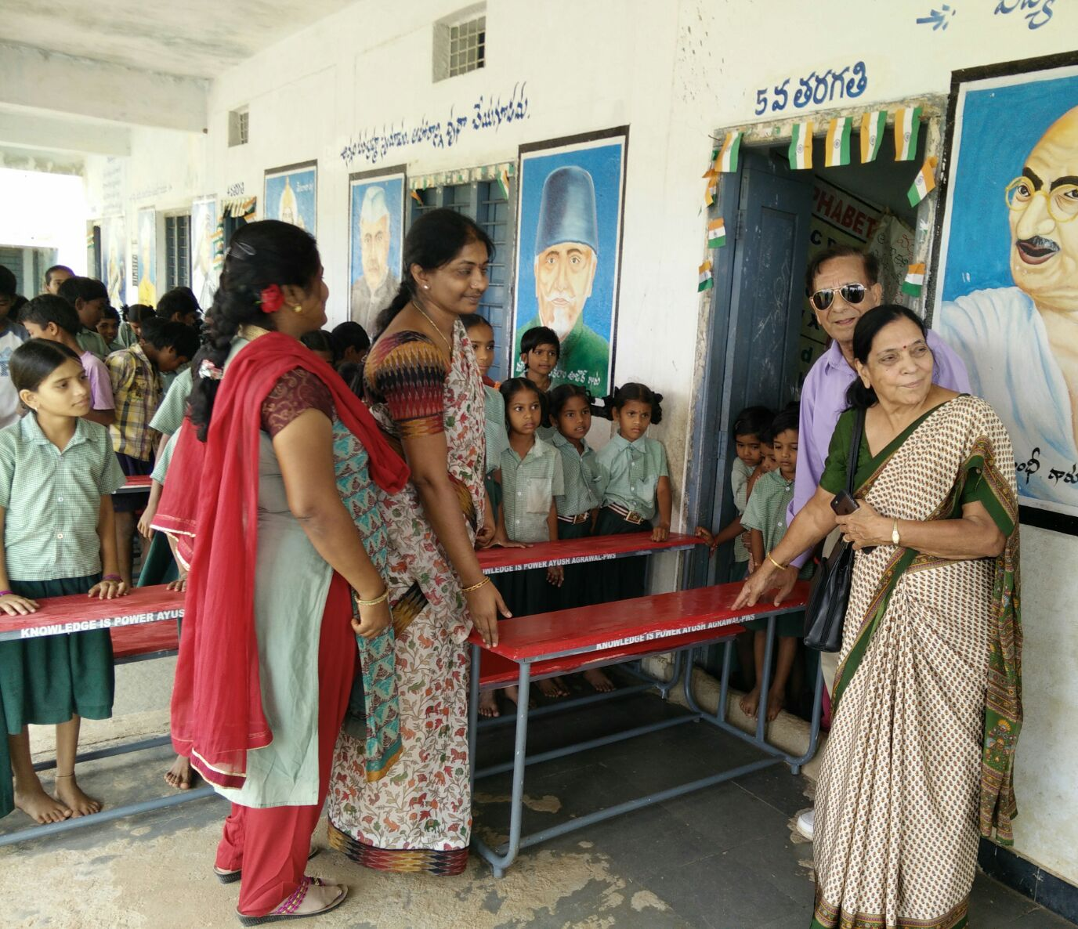
EDUCATION IMPROVEMENT
All the 850 students in Burgula high school and 7 primary schools now
use desks and chairs
www.pragathiwelfaresociety.com

Slide 11
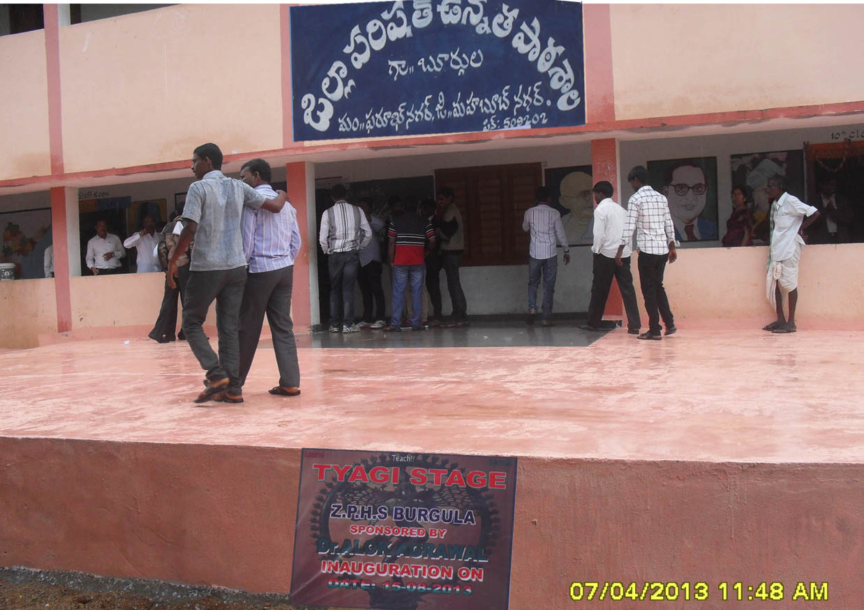
EDUCATION IMPROVEMENT
Outdoor stage construction in school
www.pragathiwelfaresociety.com

Slide 12
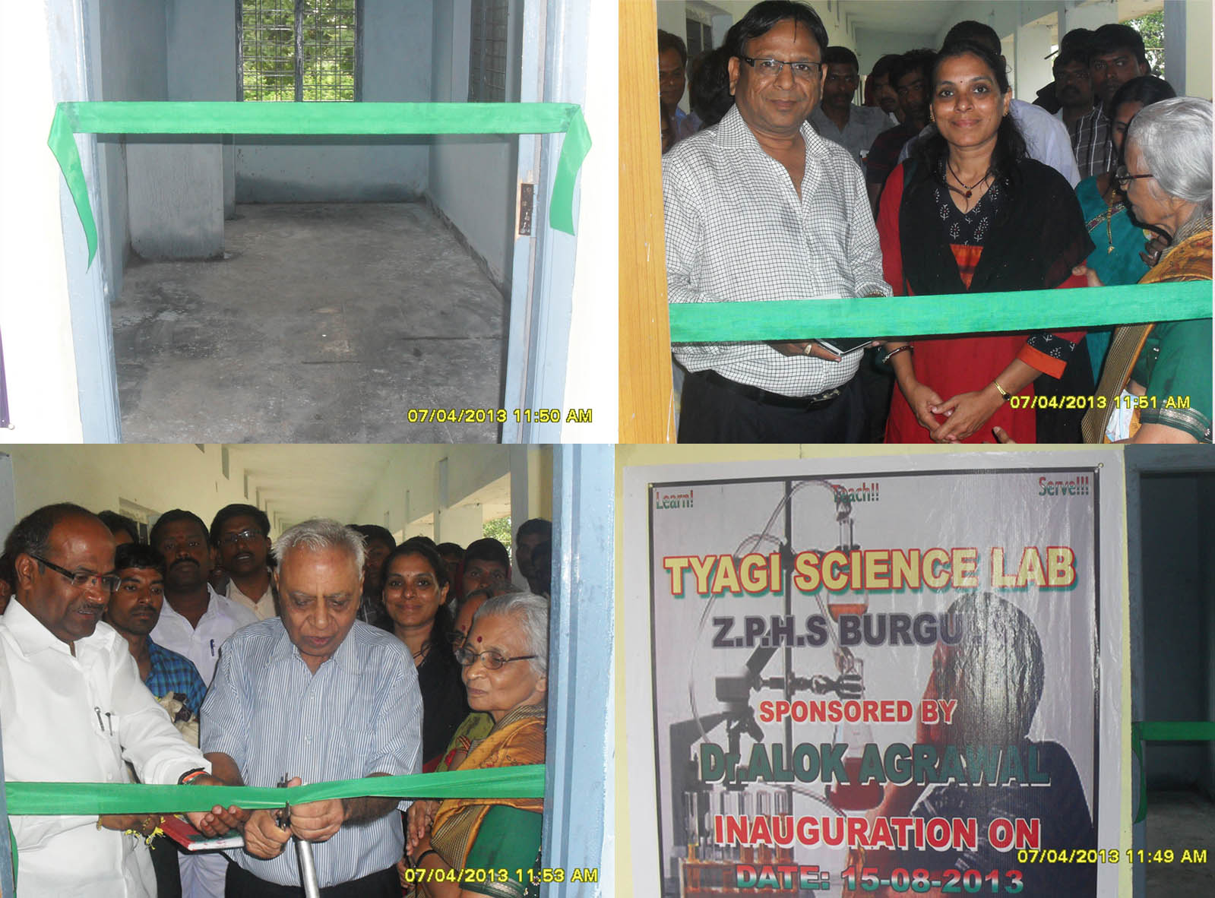
EDUCATION IMPROVEMENT
Tyagi science lab construction
www.pragathiwelfaresociety.com

Slide 13
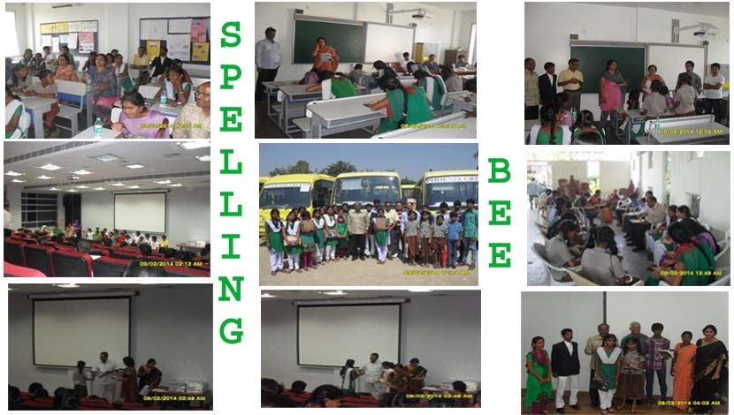
EDUCATION IMPROVEMENT
www.pragathiwelfaresociety.com

Slide 14
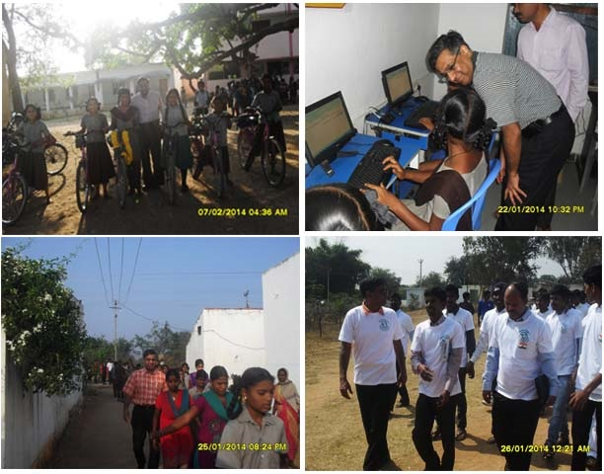
EDUCATION IMPROVEMENT
Motivating students and youth
www.pragathiwelfaresociety.com

Slide 15
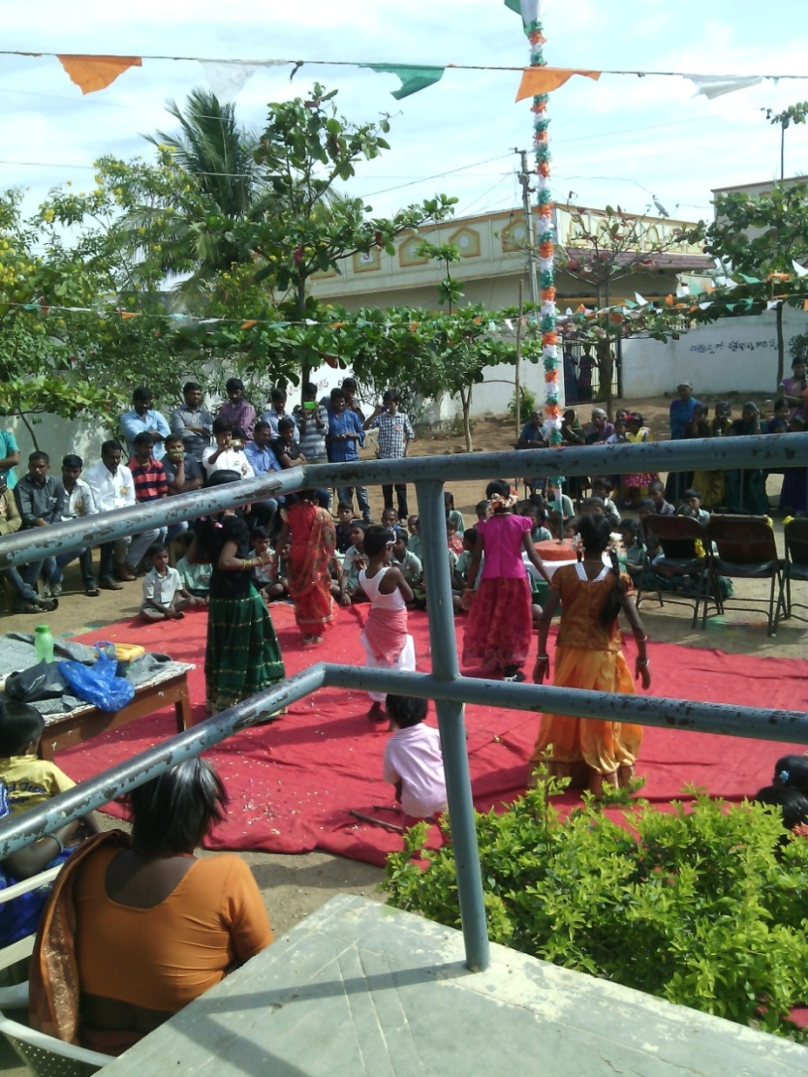
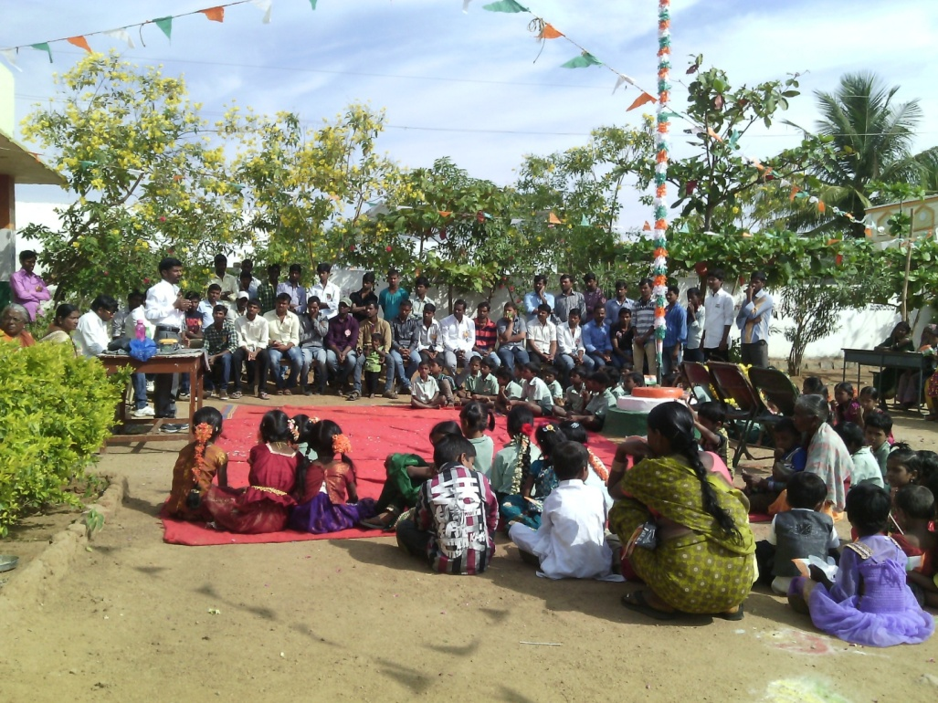
EDUCATION IMPROVEMENT
Republic Day celebrations
www.pragathiwelfaresociety.com

Slide 16
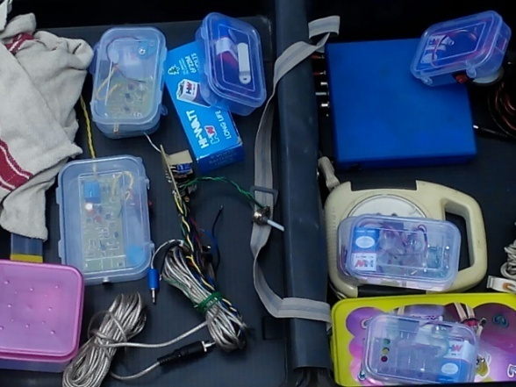
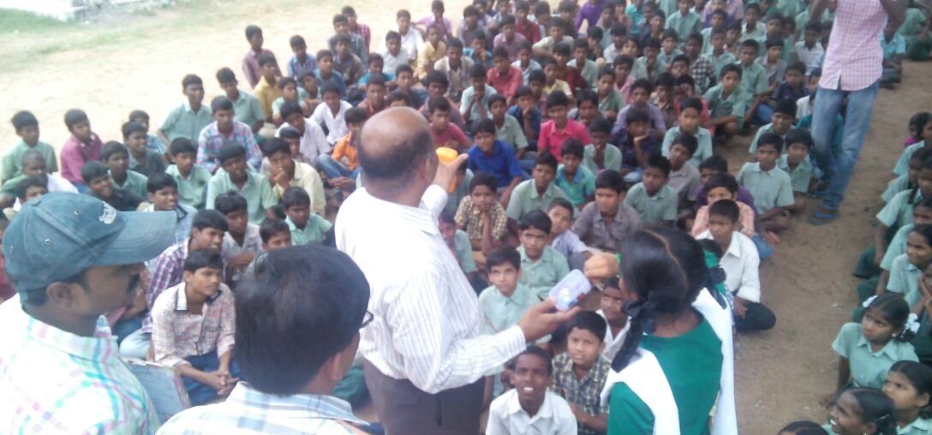
EDUCATION IMPROVEMENT
Science experiments
www.pragathiwelfaresociety.com

Slide 17
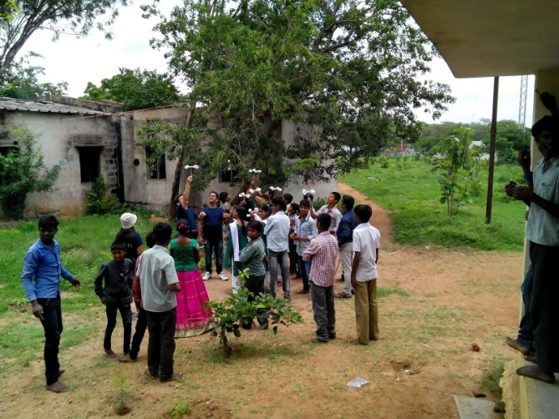
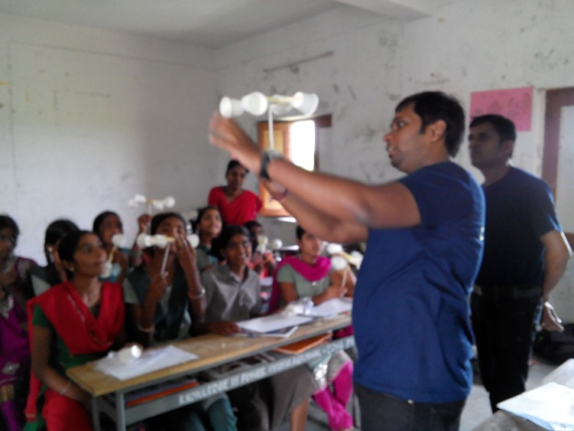
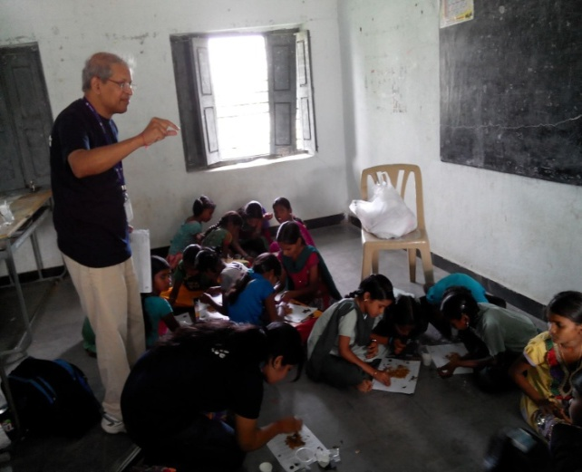
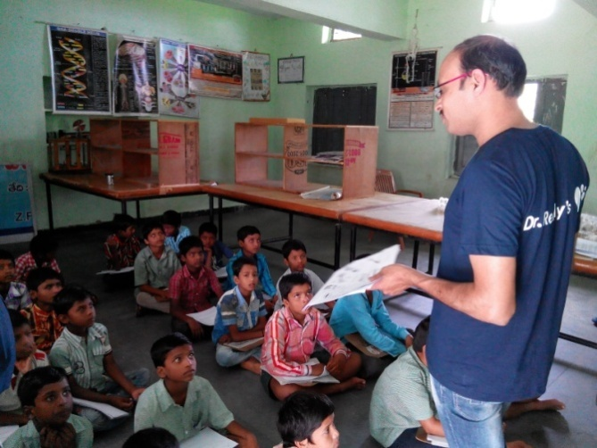
EDUCATION IMPROVEMENT
www.pragathiwelfaresociety.com

Slide 18
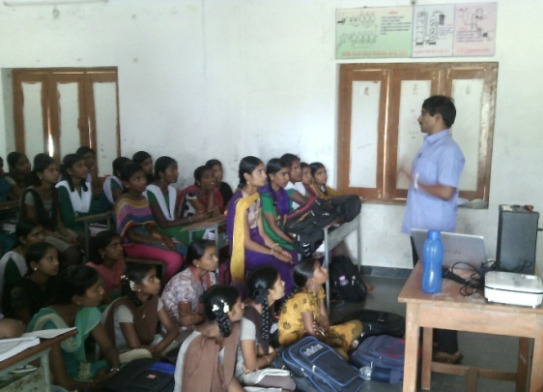
EDUCATION IMPROVEMENT
Student Empowerment Training (SET)
www.pragathiwelfaresociety.com

Slide 19
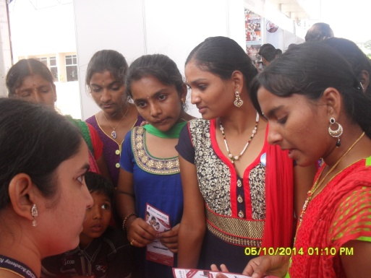
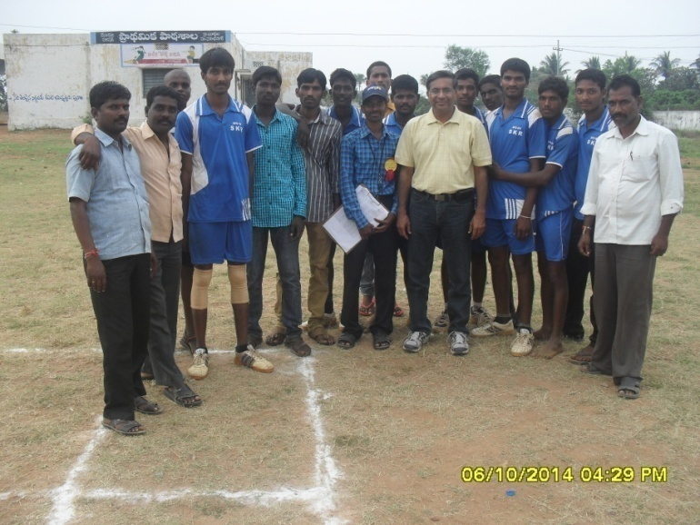
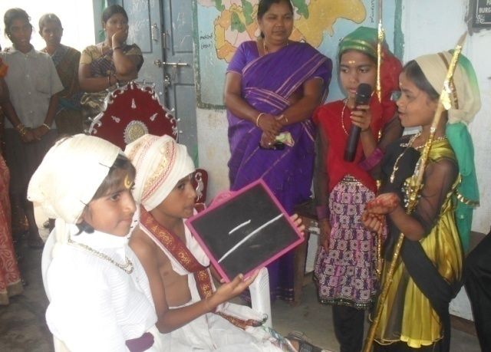
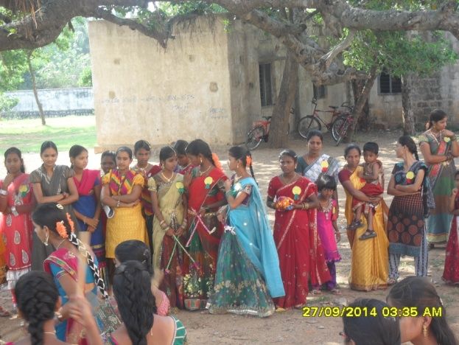
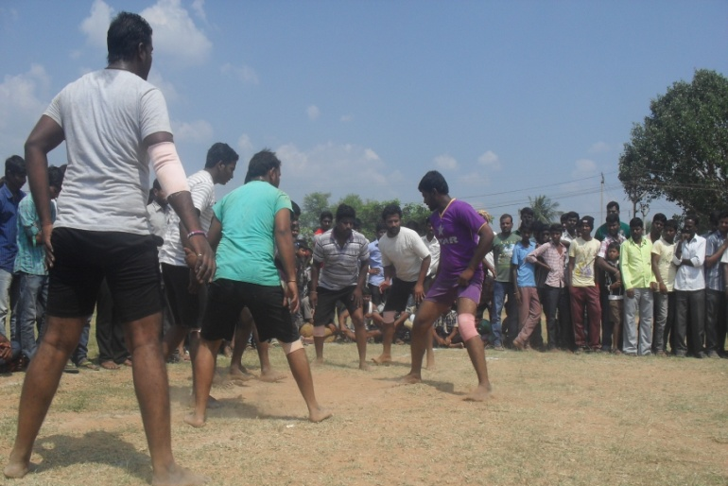
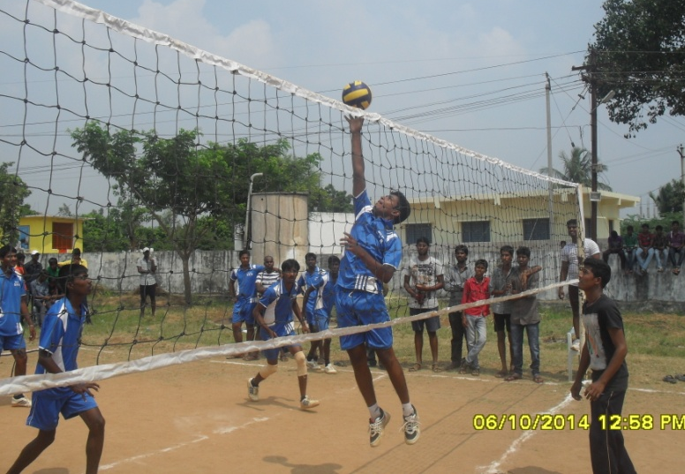
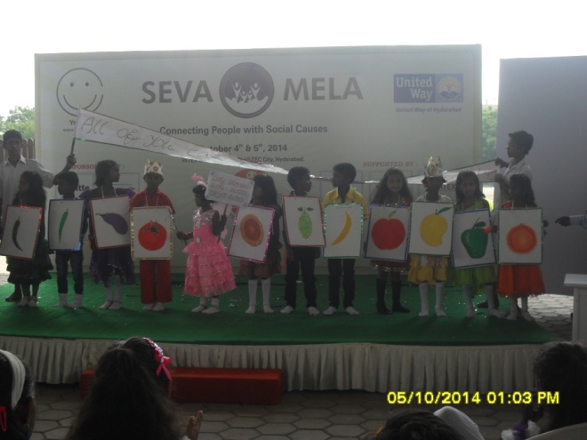
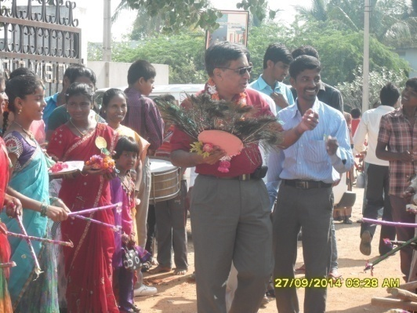
EDUCATION IMPROVEMENT
Encouraging sports and extra-curricular activities
www.pragathiwelfaresociety.com

Slide 20
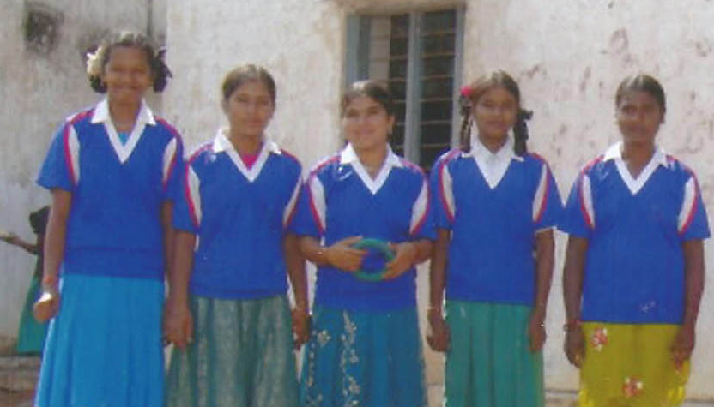
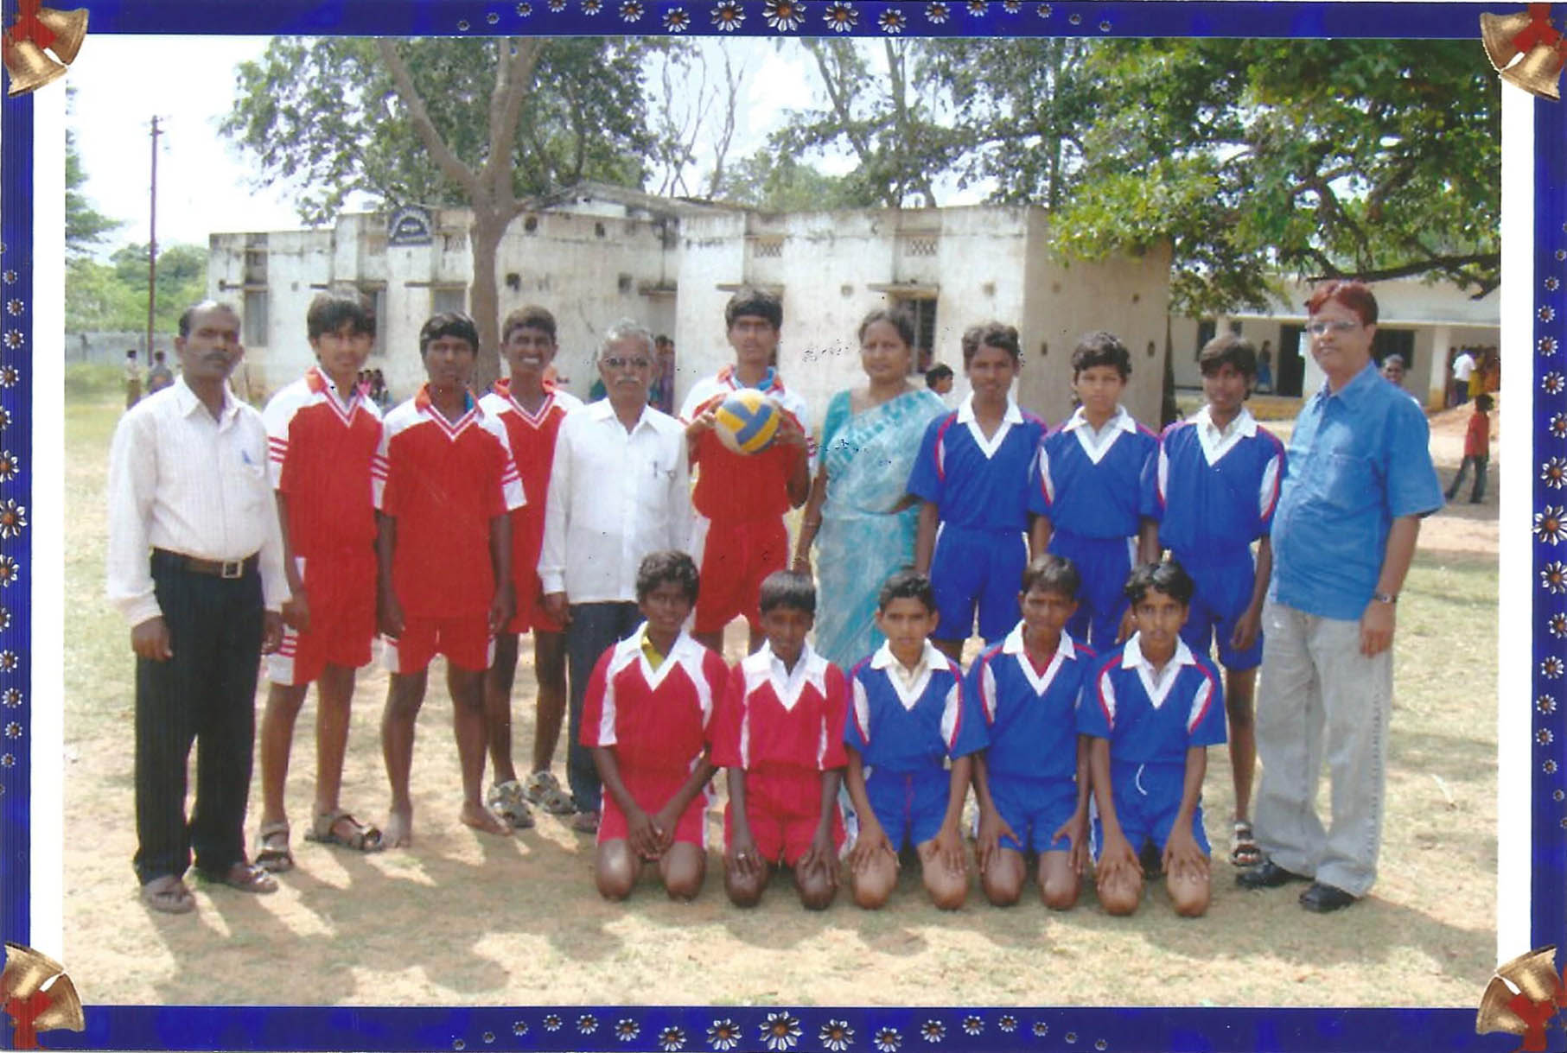
EDUCATION IMPROVEMENT
Sports uniform
and dress
www.pragathiwelfaresociety.com

Slide 21
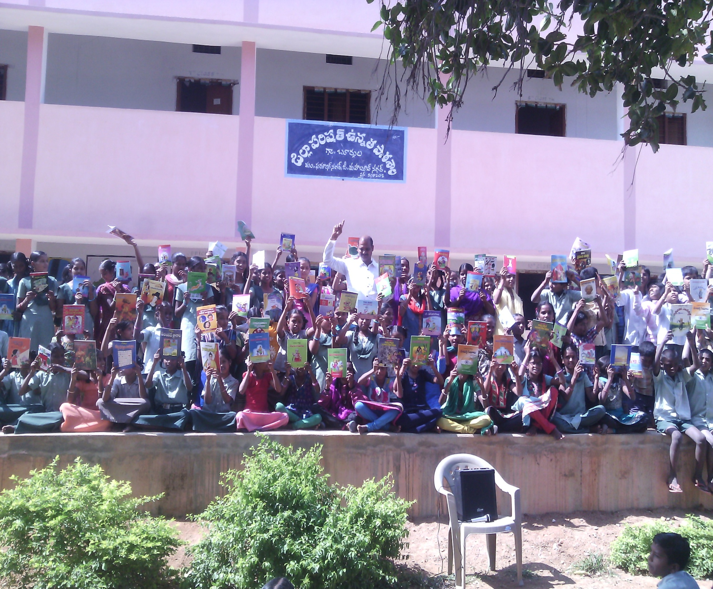
EDUCATION IMPROVEMENT
Library creation in 8 schools
www.pragathiwelfaresociety.com

Slide 22
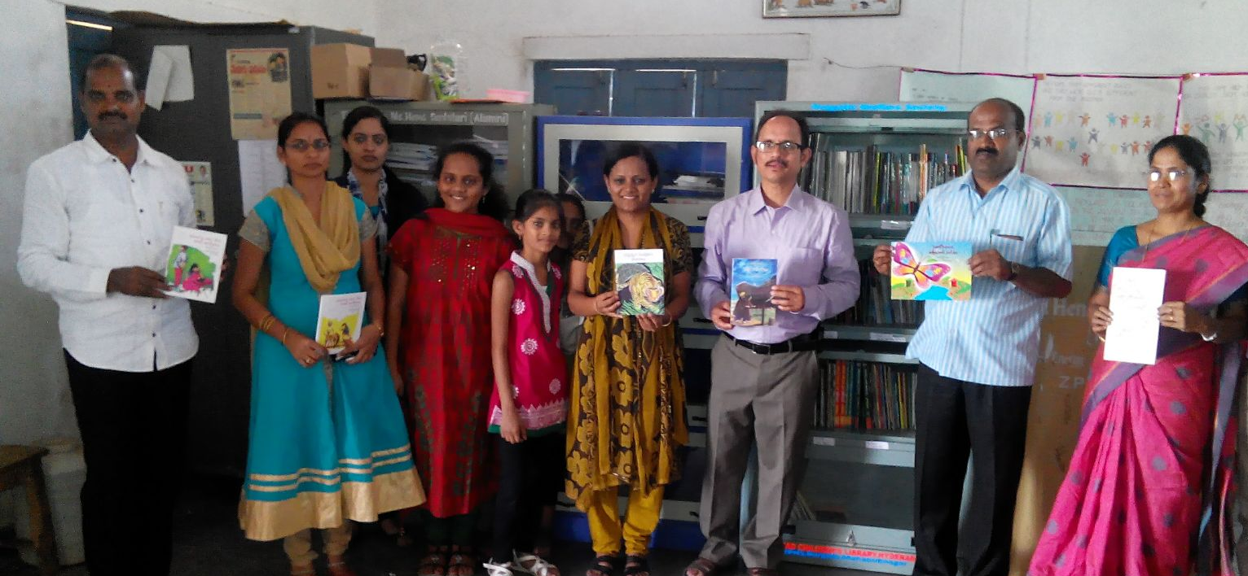
EDUCATION IMPROVEMENT
www.pragathiwelfaresociety.com

Slide 23
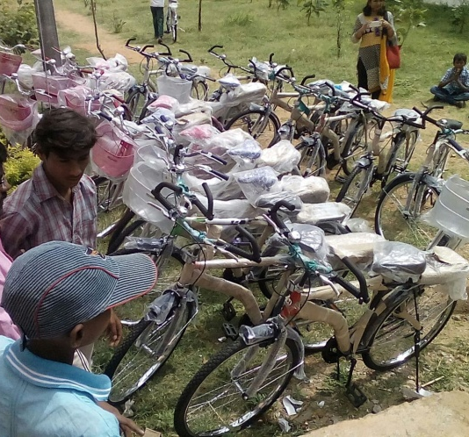
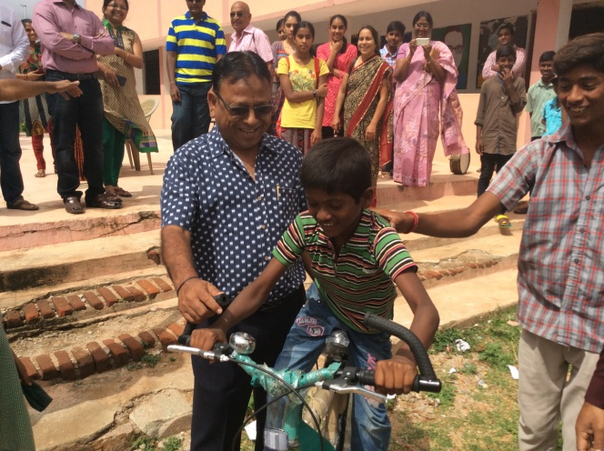
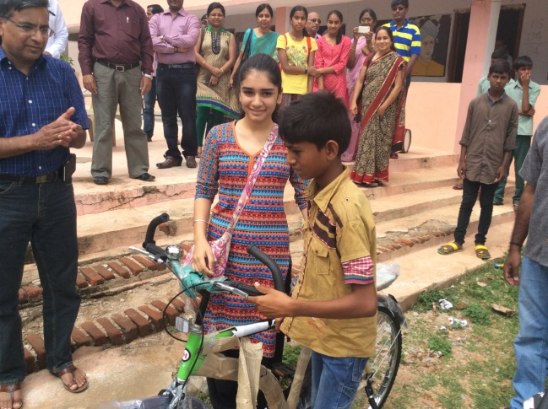
EDUCATION IMPROVEMENT
Bicycles distribution in Burgula high school
www.pragathiwelfaresociety.com

Slide 24
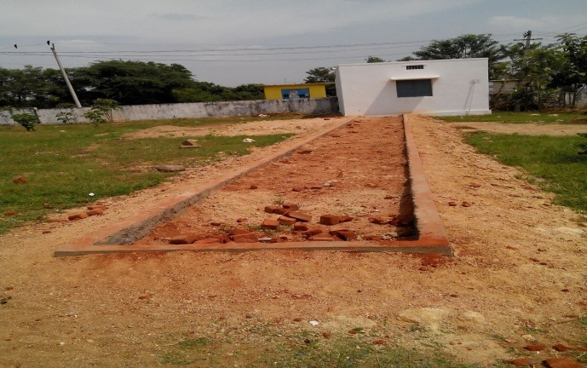
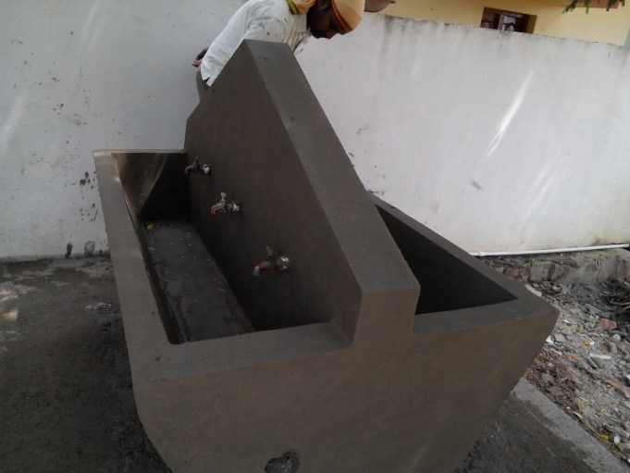
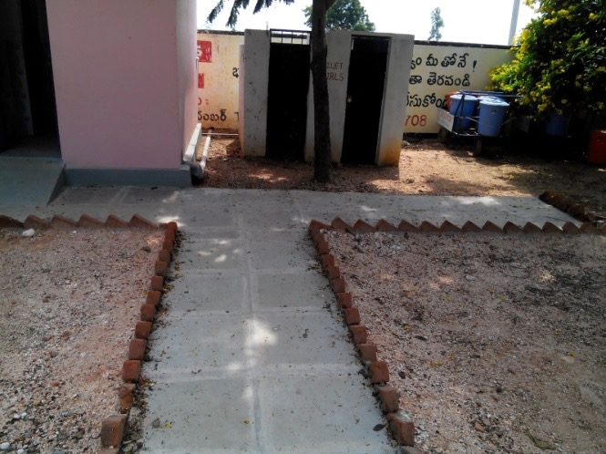
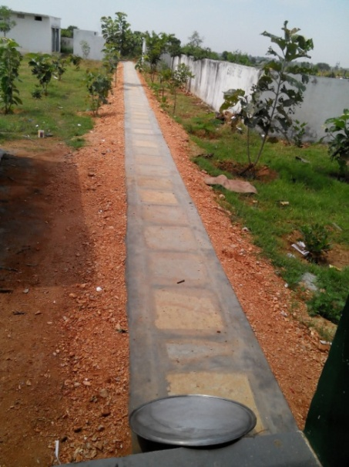
EDUCATION IMPROVEMENT
Beautification of primary
school
Clean up
Walking passage
Planting of trees
Open drainage closure
New toilet
Multi-tap basin
Roof leakage repairing
www.pragathiwelfaresociety.com

Slide 25
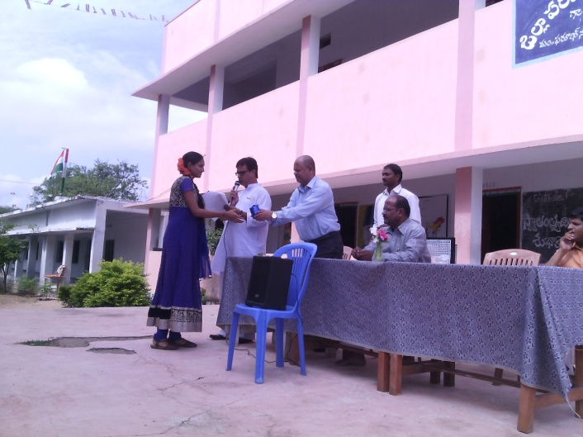
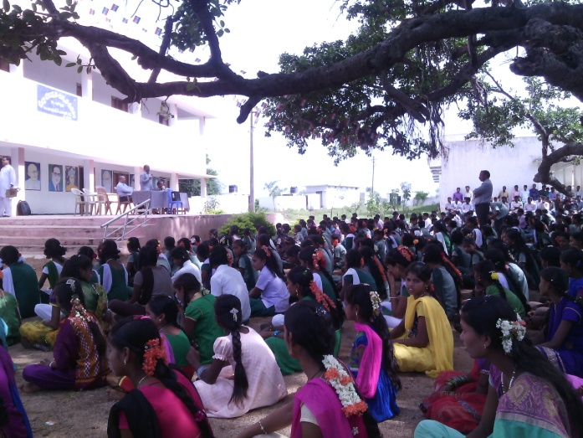
EDUCATION IMPROVEMENT
Academic excellence
awards to students
on August 15th
www.pragathiwelfaresociety.com

Slide 26
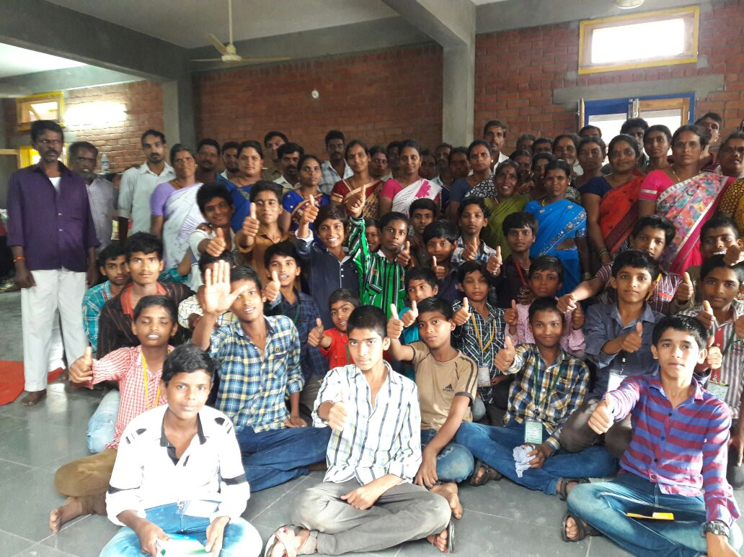
EDUCATION IMPROVEMENT

Slide 27
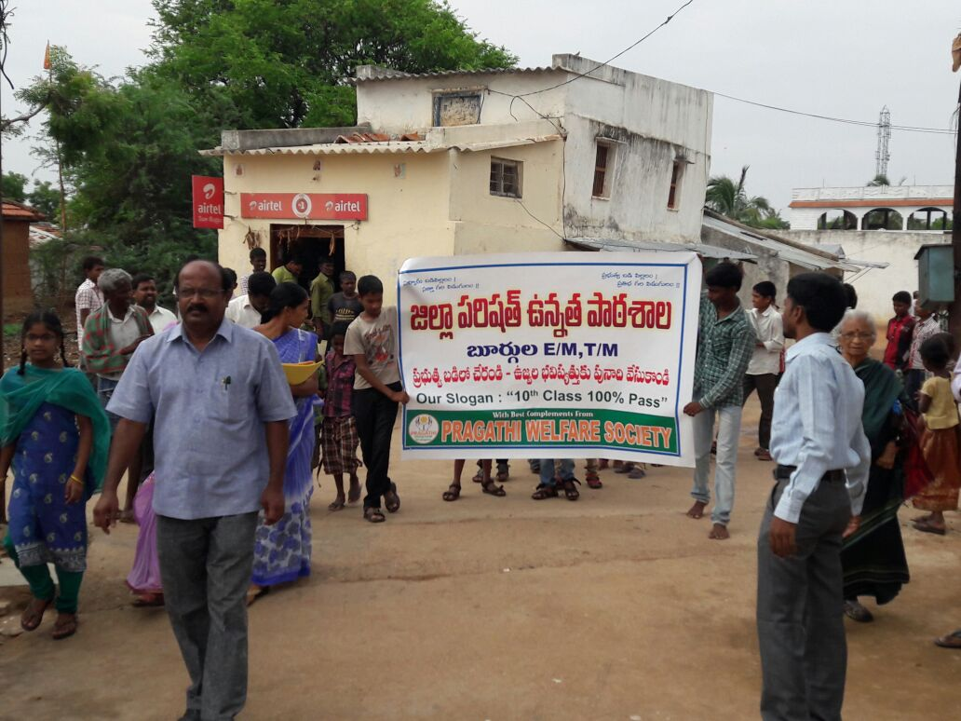
EDUCATION IMPROVEMENT

Slide 28
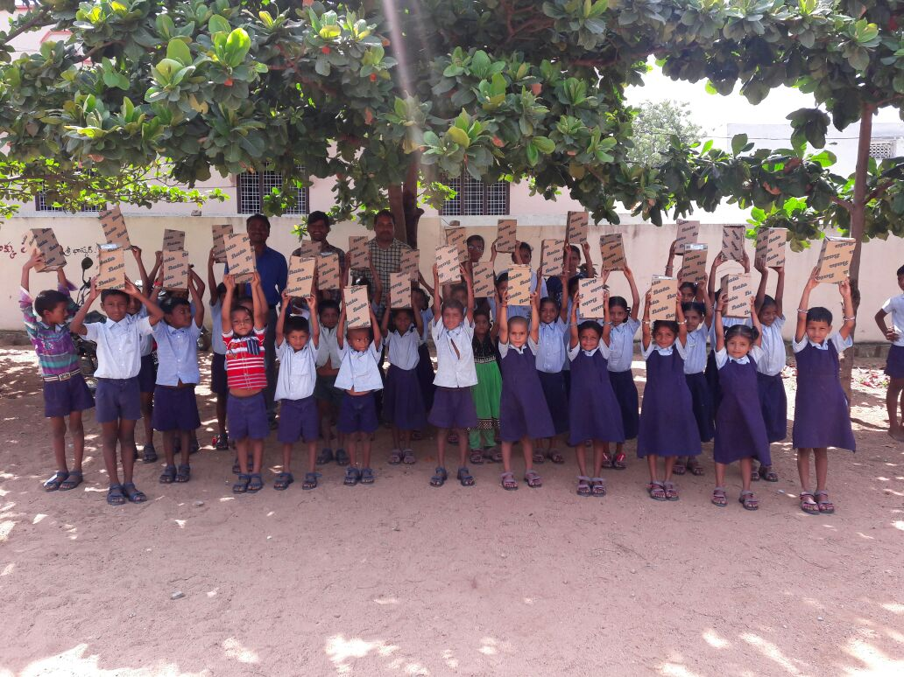
Footwear for 800 students

Slide 29
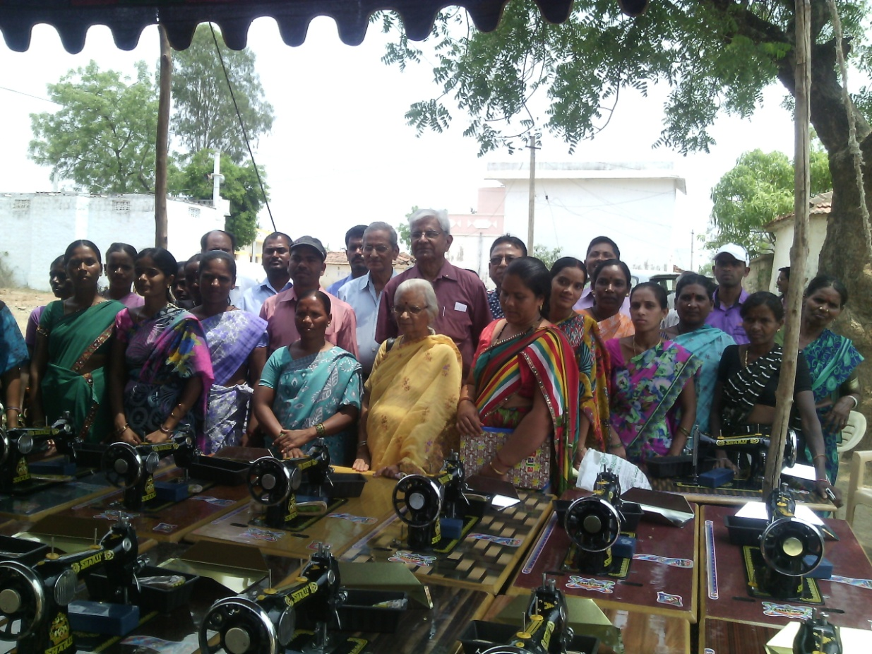
WOMEN EMPOWERMENT
145 Sewing machines distributed
www.pragathiwelfaresociety.com

Slide 30
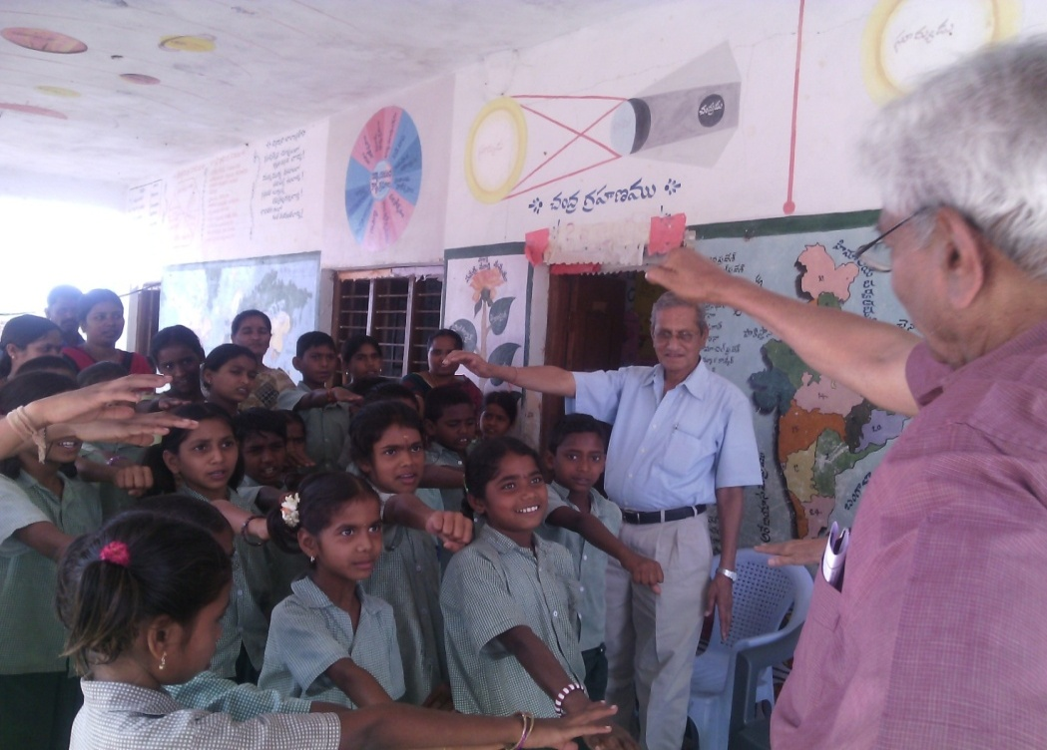
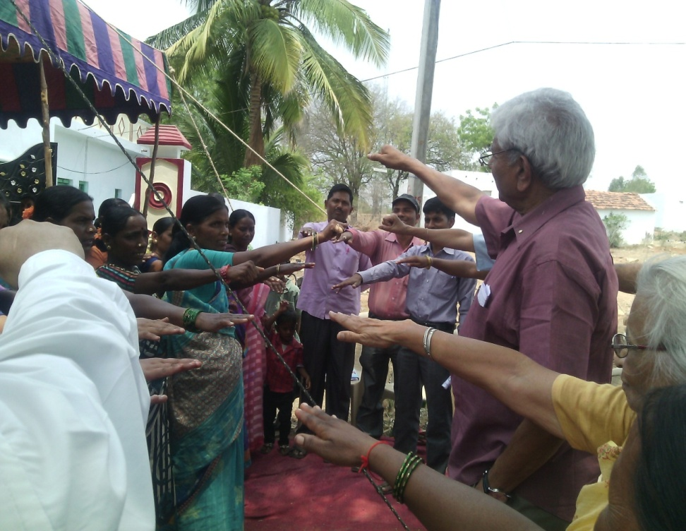
WOMEN EMPOWERMENT
Women taking oath that they will send their children to school, not support child marriages and will become self-reliant
www.pragathiwelfaresociety.com

Slide 31
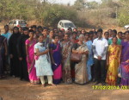
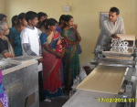
VISIT TO NATIONAL INSTITUTE OF RURAL DEVELOPMENT
Exploring New Opportunities
www.pragathiwelfare society.com

Slide 32
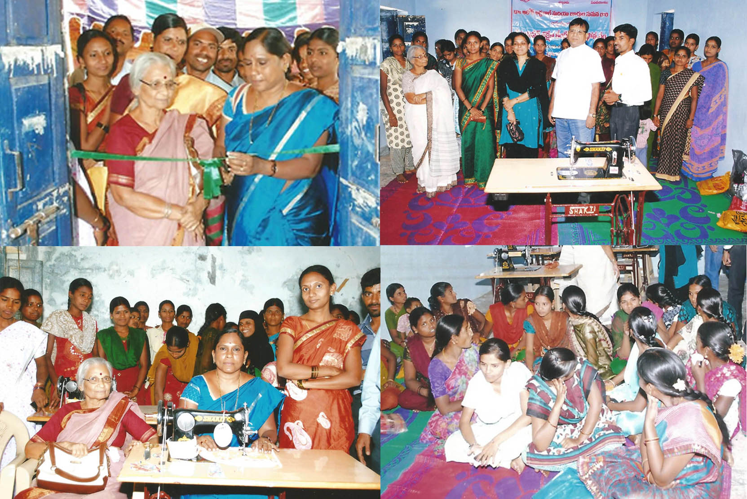
WOMEN EMPOWERMENT
Stitching center
www.pragathiwelfaresociety.com

Slide 33
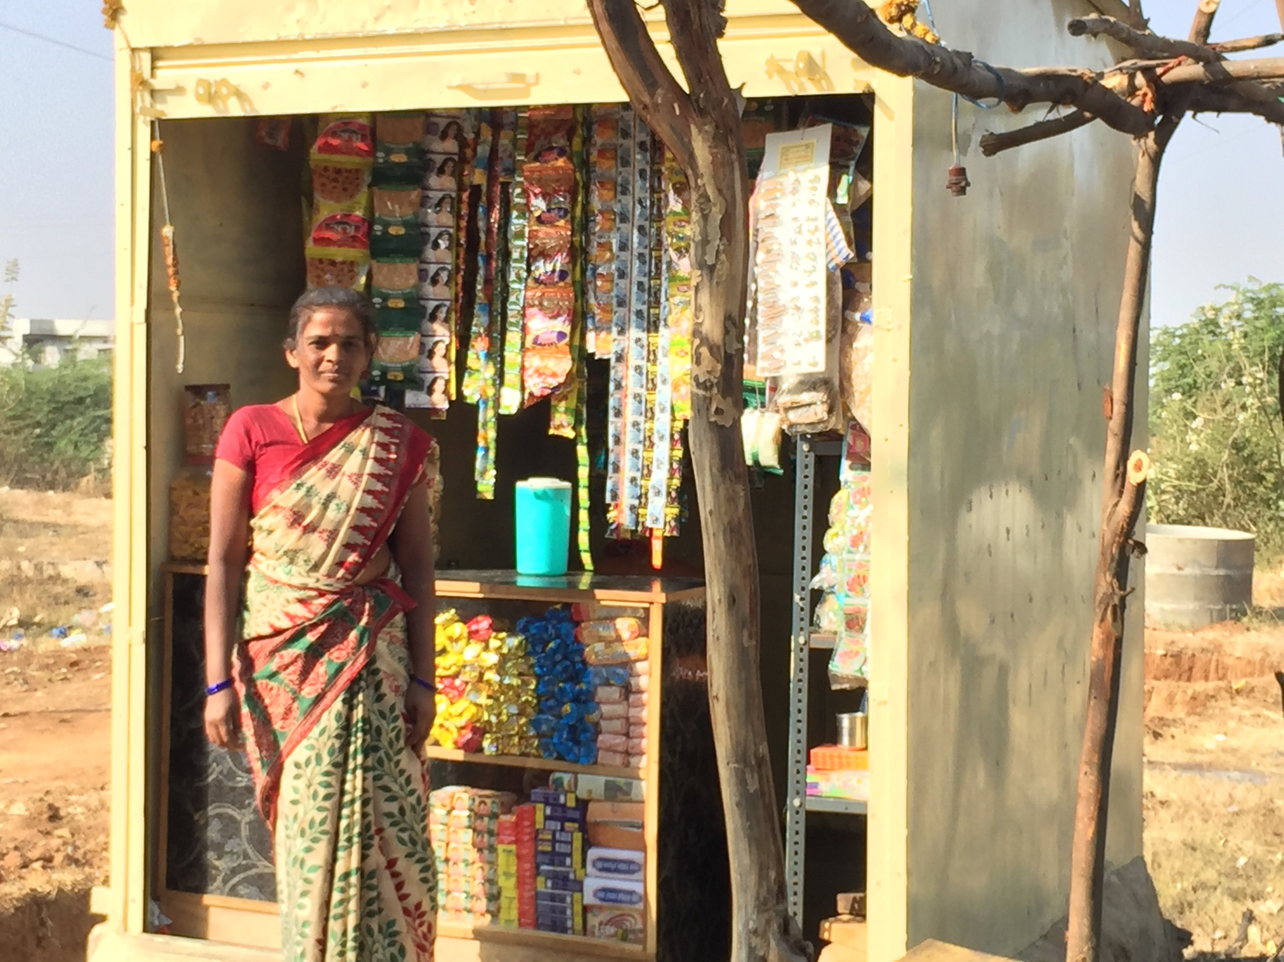
WOMEN EMPOWERMENT

Slide 34

WOMEN EMPOWERMENT

Slide 35

WOMEN EMPOWERMENT
www.pragathiwelfaresociety.com

Slide 36



WOMEN EMPOWERMENT
Inauguration of
Mahila Mandal building
www.pragathiwelfaresociety.com

Slide 37




YOUTH DEVELOPMENT
www.pragathiwelfaresociety.com

Slide 38

Youth Development

Slide 39

Youth Development

Slide 40

Youth Development

Slide 41


YOUTH DEVELOPMENT
Annual youth festival
www.pragathiwelfaresociety.com

Slide 42




YOUTH FESTIVAL
16 teams from different villages participated in two days youth festival. Prizes were distributed to winners and they were made aware of employment and skill development opportunities
www.pragathiwelfaresociety.com

Slide 43
There is a Primary Healthcare Centre
Our focus is to provide preventive health care through village clean up, clean drinking water, proper use of toilets and other programs
PREVENTIVE HEALTH CARE
www.pragathiwelfaresociety.com

Slide 44


PRVENTIVE HEALTH CARE
Clean drinking water project
www.pragathiwelfaresociety.com

Slide 45


PREVENTIVE HEALTH CARE
Water treatment plant is providing clean drinking water to the village and employment to two youths
www.pragathiwelfaresociety.com

Slide 46



PREVENTIVE HEALTH CARE
World AIDS Day celebration through a rally across the village
www.pragathiwelfaresociety.com

Slide 47

PREVENTIVE HEALTH CARE-Toilets

Slide 48

PREVENTIVE HEALTH CARE- Village clean up

Slide 49



BLOOD DONATION CAMP
www.pragathiwelfaresociety.com

Slide 50





EYE CAMPS
www.pragathiwelfaresociety.com

Slide 51




ASTHMA AWARENESS CAMP
www.pragathiwelfaresociety.com

Slide 52


AWARENESS WALK
AND CAMP
ON
WORLD DIABETES DAY
www.pragathiwelfaresociety.com

Slide 53

www.pragathiwelfaresociety.com

Slide 54



COMMUNITY PARTICIPATION
www.pragathiwelfaresociety.com

Slide 55


SEVA MELA 2014
Rice bucket challenge
www.pragathiwelfaresociety.com

Slide 56

COMMUNITY PARTICIPATION
Blood Donation Camp:30 people donated blood to organization named ISRA
Door-to-Door Campaign Team motivated every parent of 10th class students to get better results. We explained the importance of health, village clean up, toilets and education.
www.pragathiwelfaresociety.com

Slide 57



COMMUNITY PARTCIPATION
Visited Seva Mela
Door-to-door awareness in tribal areas
Motivational videos
Youth motivated to speak
Donation of rice
www.pragathiwelfare
society.com

Slide 58

COMMUNITY PARTICIPATION
www.pragathiwelfaresociety.com

Slide 59


Slide 60


Slide 61

NEW CLOTHES DISTRIBUTION
www.pragathiwelfaresociety.com

Slide 62
FUTURE PROJECTS OF
PRAGATHI
Improve quality of education
Computer literacy
Skill training and employment
Clean drinking water
Open defecation free
Village Clean up
Rural Development Center for Mandal
www.pragathiwelfaresociety.com

