Slide 1

Press Releases of

Slide 2
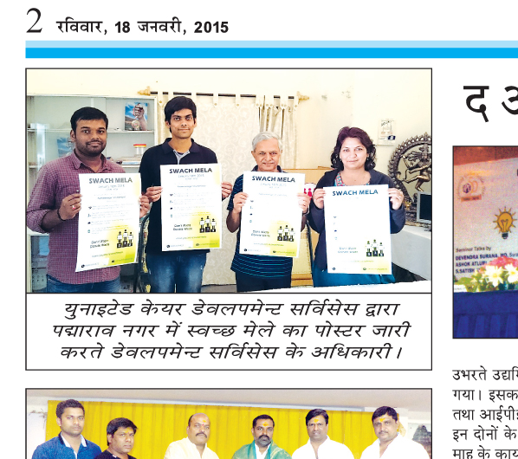

Hindi Milap -– 18th January 2015
Swach mela Poster Release

Slide 3
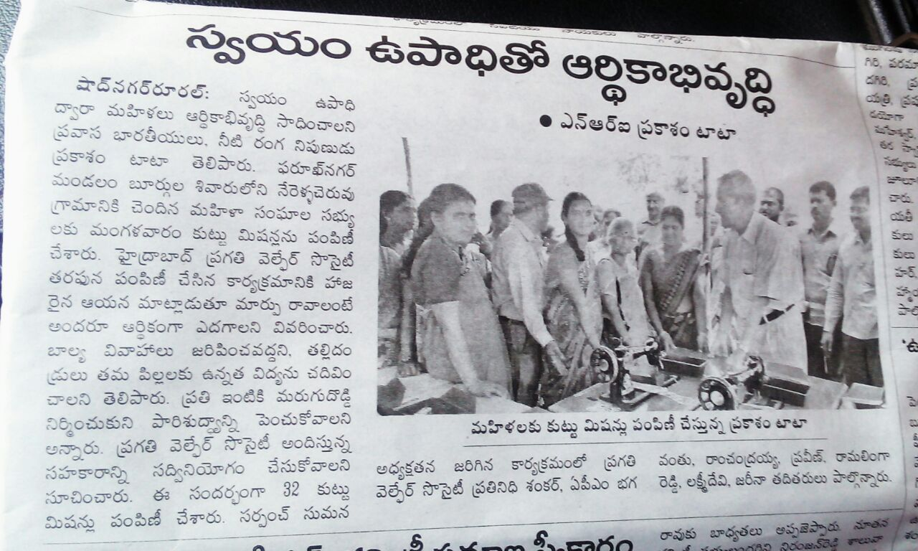
31st March 2015
Distribution of Sewing Machines at Nerella Cheru Village

Slide 4
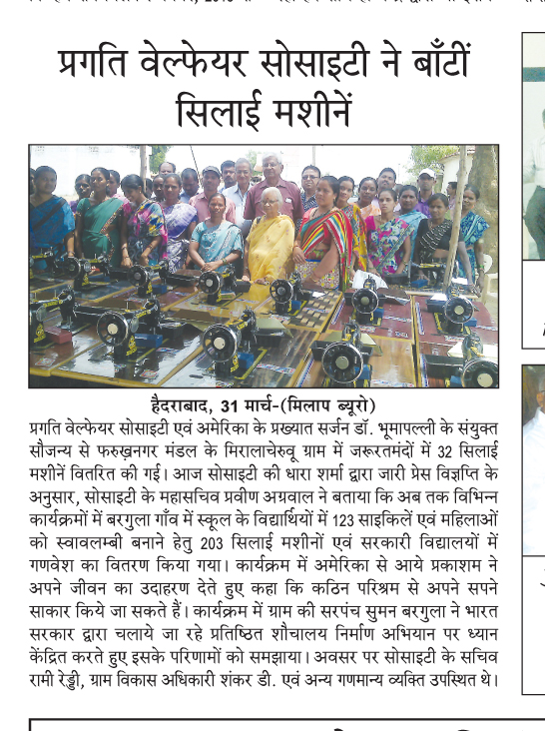
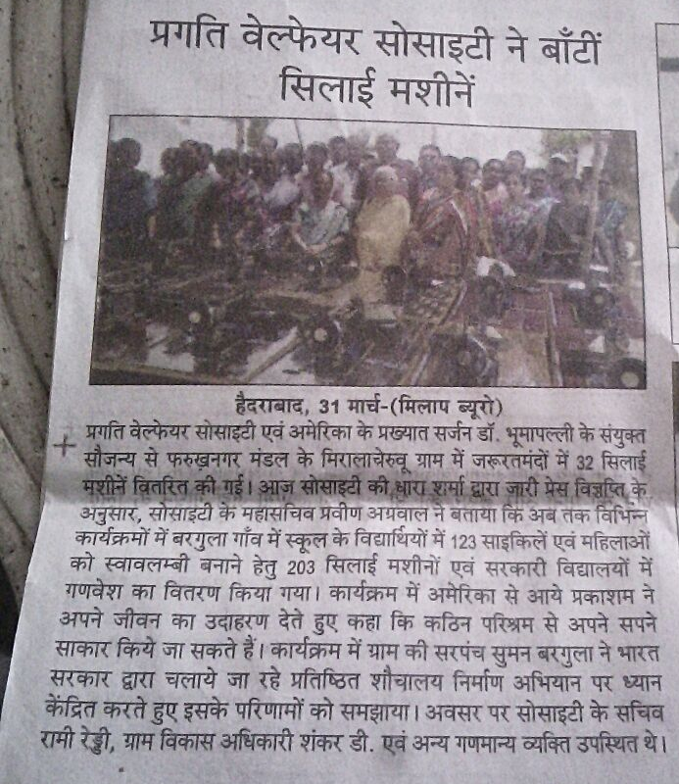
Hindi Milap- 31st March 2015
Distribution of Sewing Machines at Nerella Cheru Village

Slide 5
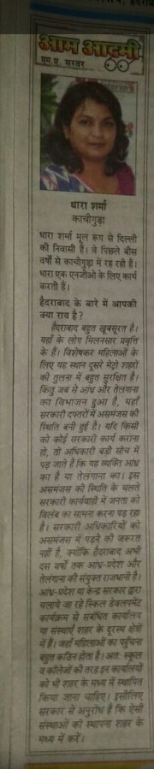
Hindi Milap- 15th May 2015
PWS – Administrative Officer – Small Interview

Slide 6
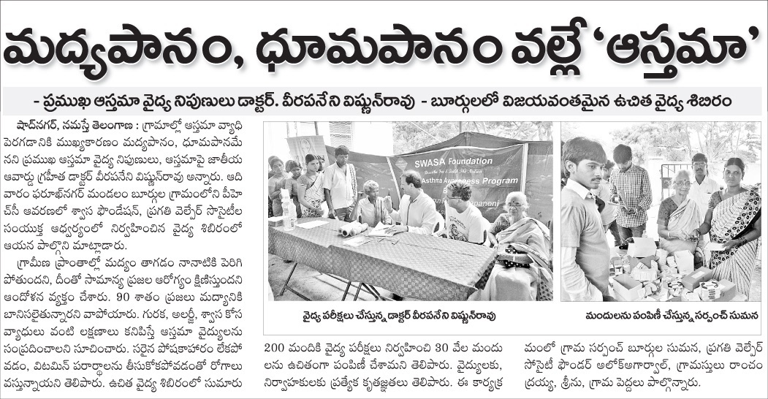
Namasthay Telangana- -19th July 2015
Awareness Camp on Asthama

Slide 7
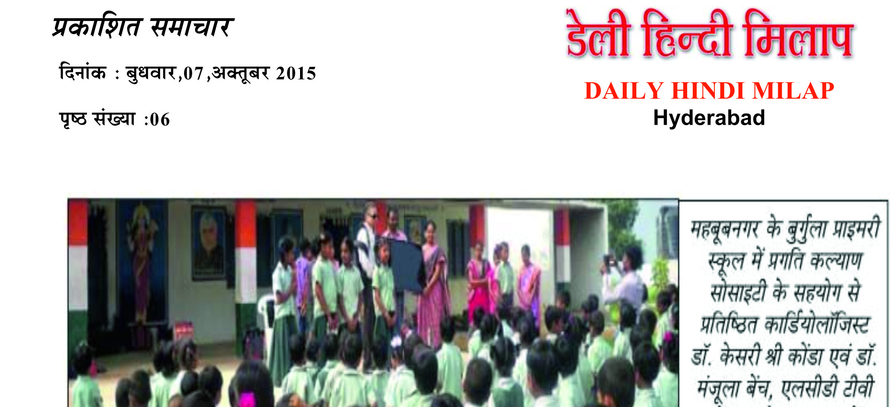
Hindi Milap – 7th October 2015
LCD Donation to facilitate Education

Slide 8
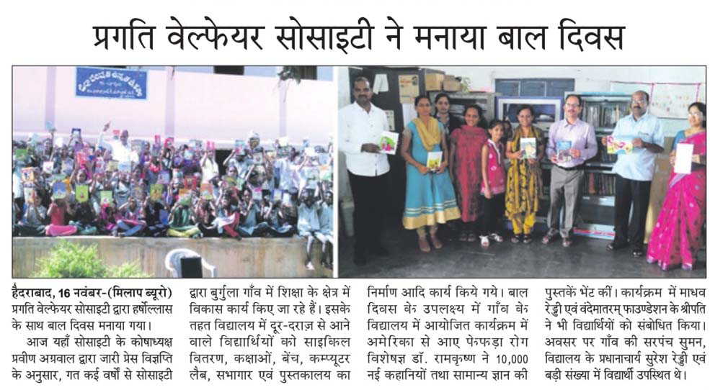
Hindi Milap - - 14th Novemeber 2015
Childrens Day Celebration

Slide 9
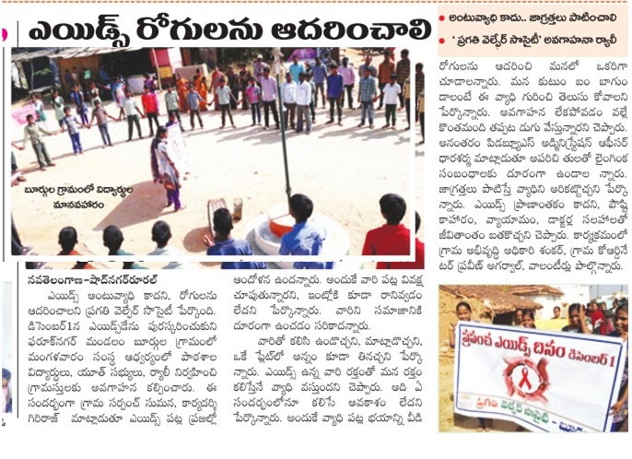
Nav Telangana- – Ist Dec 2015
Awareness Campaign on Worlds Aids Day

Slide 10
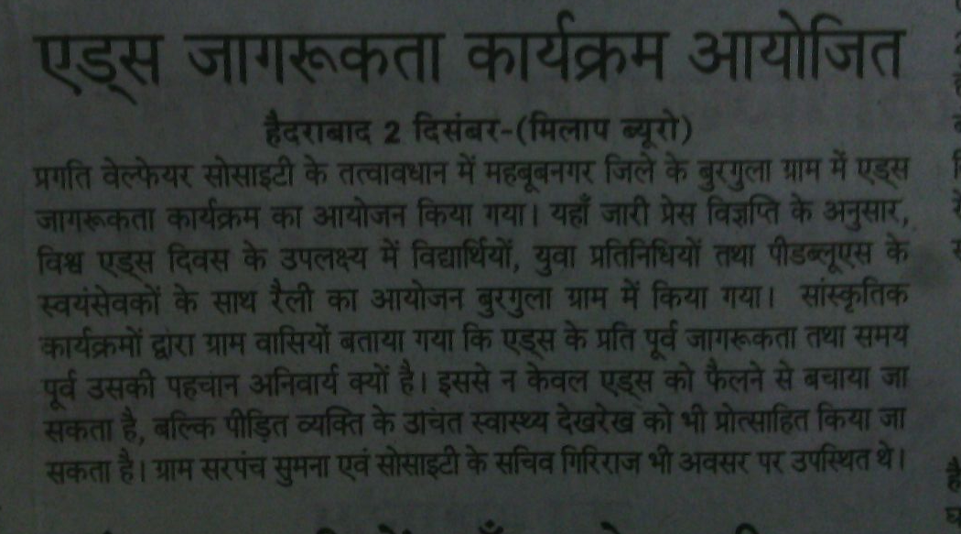
Hindi Milap – Ist Dec 2015
Awareness campaign on Worlds Aids Day

Slide 11
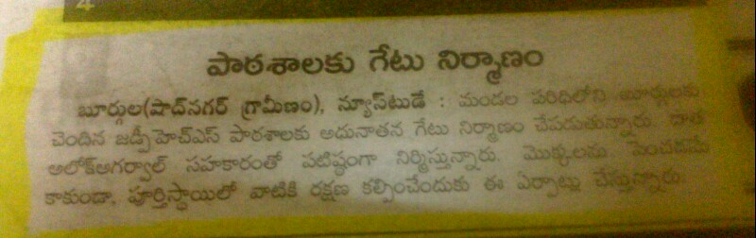
Enadu- 3rd Jan 2016
Work in Burgula High School

Slide 12
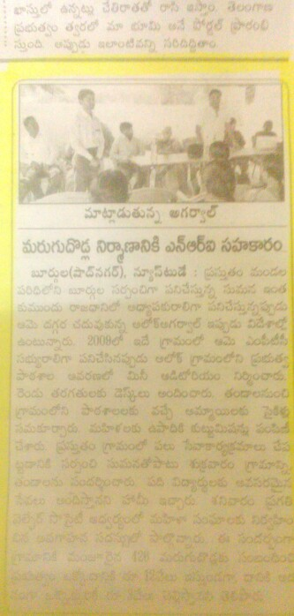
Enadu - 10th Jan 2016
Pragathi Involvement in Toilet Construction

Slide 13
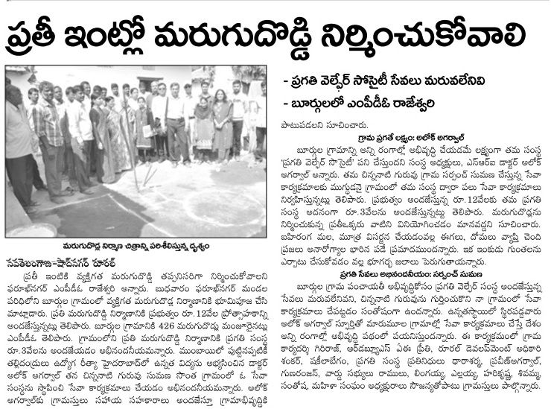
Nav Telangana- I3th Jan 2016
Inaugural for Toilet Construction

Slide 14
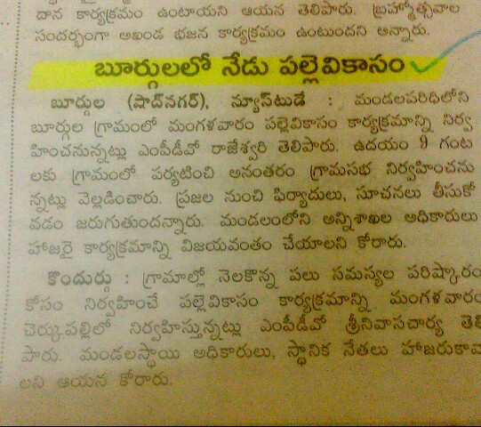
Enadu
12th Jan 2016 -

Slide 15
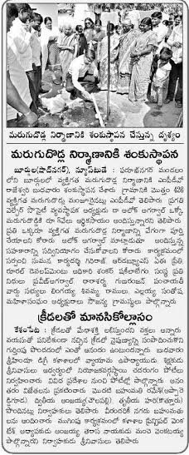
I3th Jan 2016
Inaugural for Toilet Construction –

Slide 16
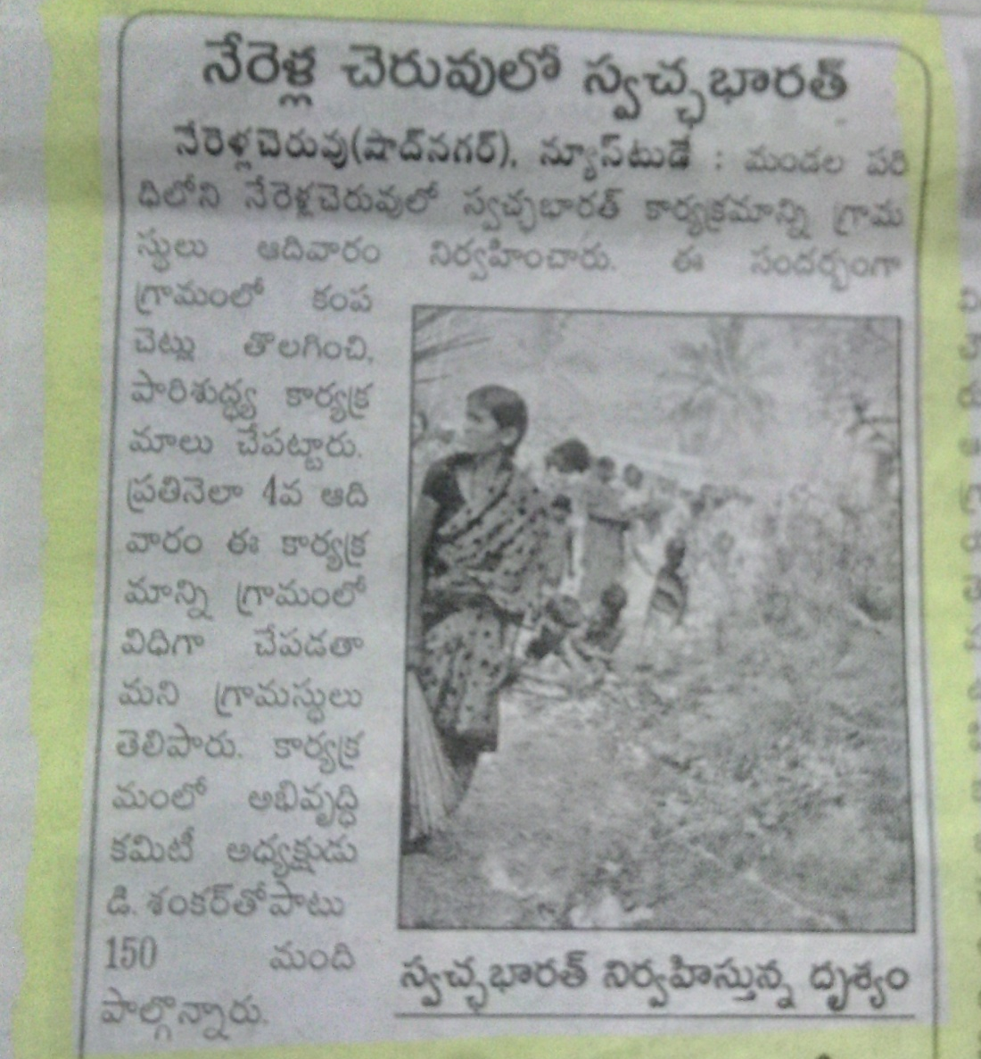
Enadu – 25th January 2016
Swach Bharat at Nerellacheru

Slide 17
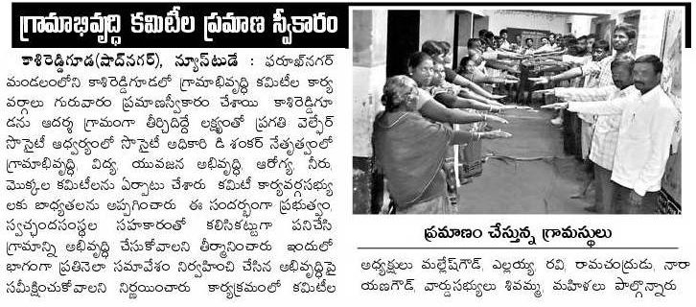
Enadu - – I3 Jan 2016
Oath taking for Village development

Slide 18
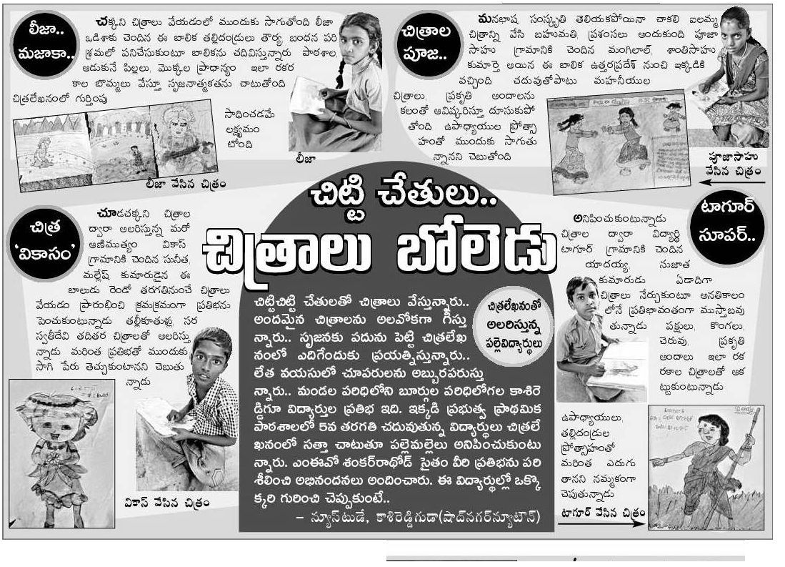
Eenadu
2016

Slide 19
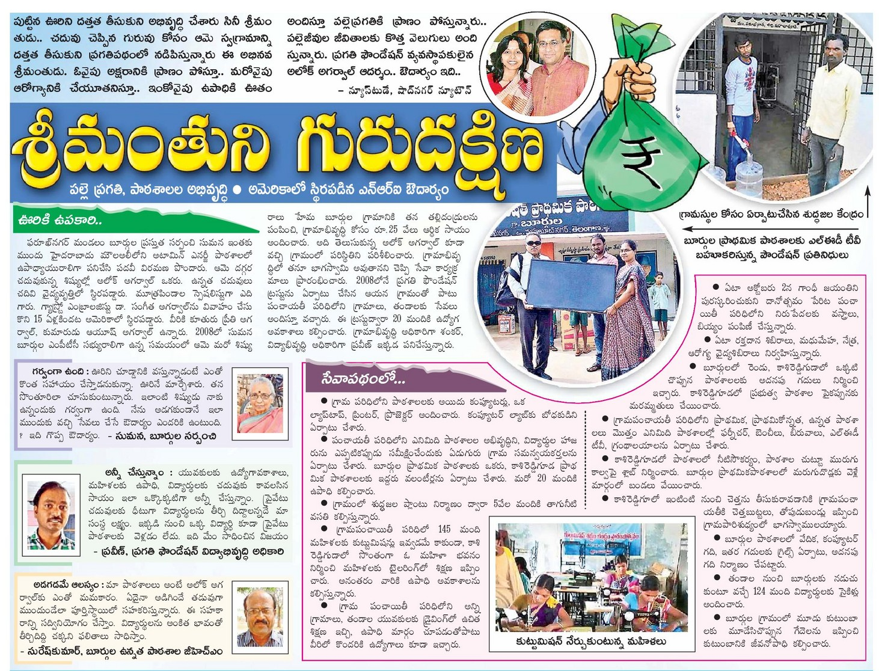
Enadu- 28th january 2016
Burgula Activities Overview

Slide 20
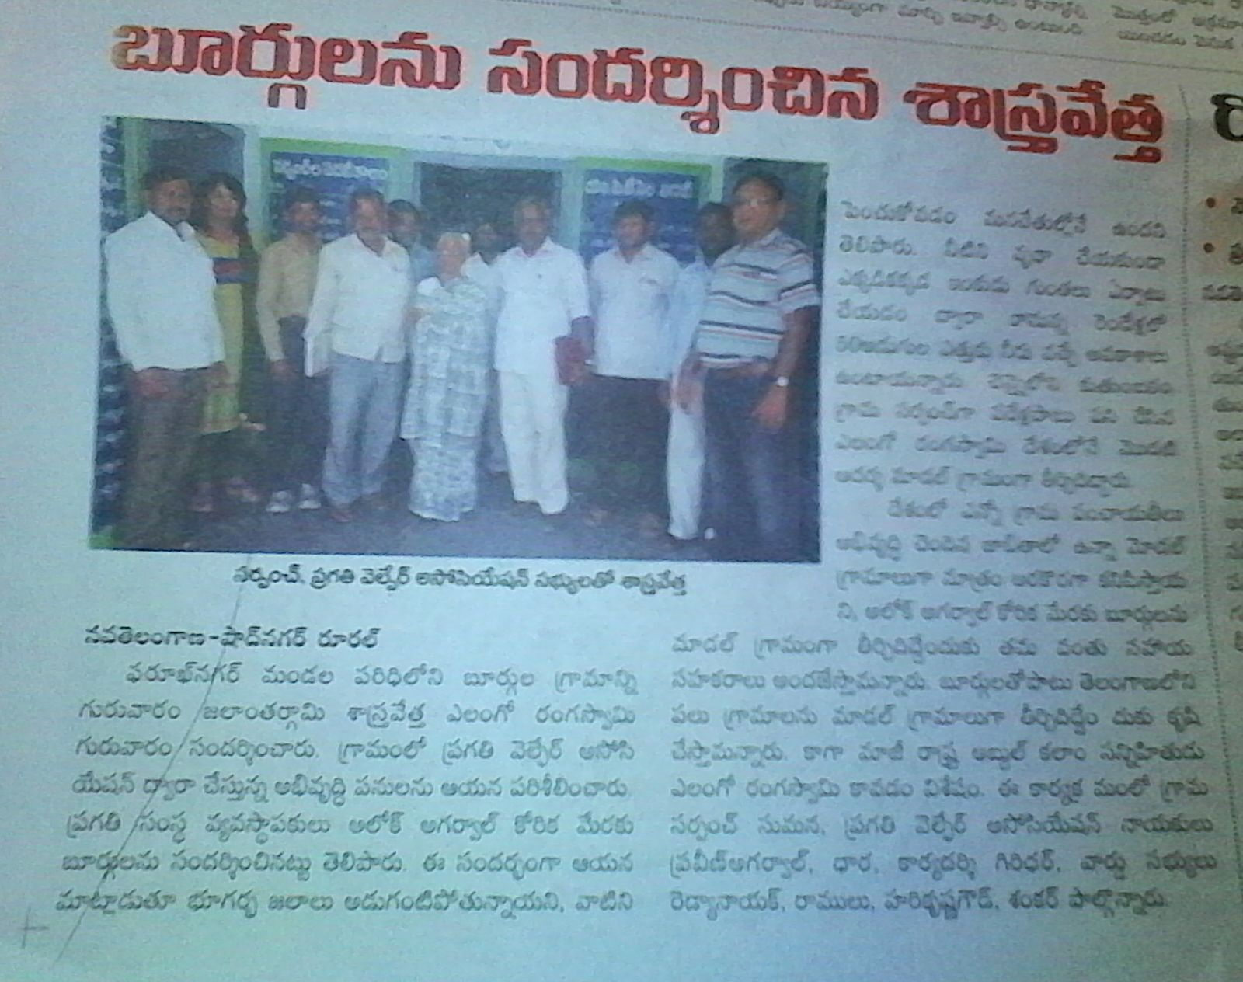
Nav Telangana- 4th February – 2016
Gram Panchayat Meeting for Village development plan

Slide 21
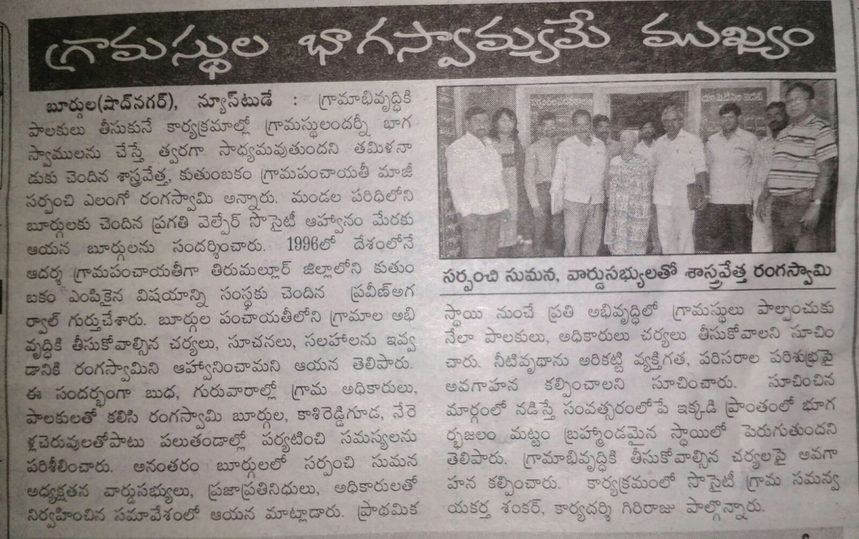
Eenadu - 4th February – 2016
Gram Panchayat Meeting for Village development plan

Slide 22
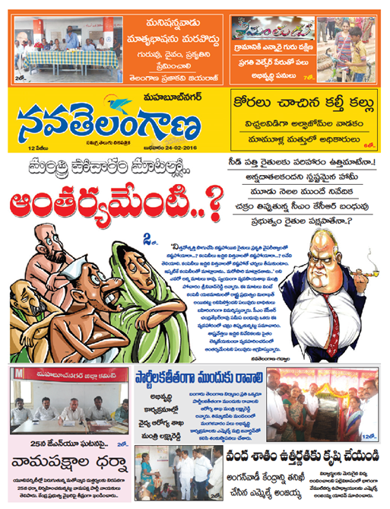
Nav Telangana 24th February
About Pragthi Activities in Burgula

Slide 23
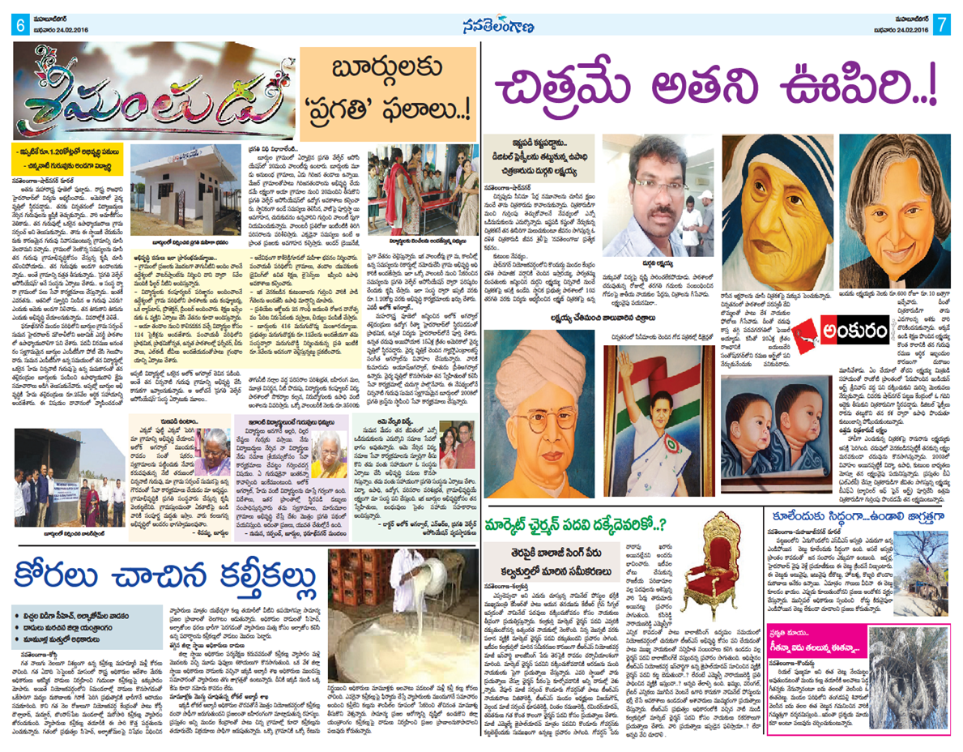
Nav Telangana- 24th February –
About Pragthi Activities in Burgula

Slide 24
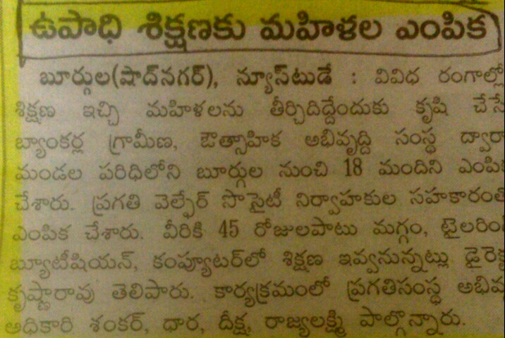
Eenadu - 11th February – 2016
Skill Training for Girls at APBIRED

Slide 25
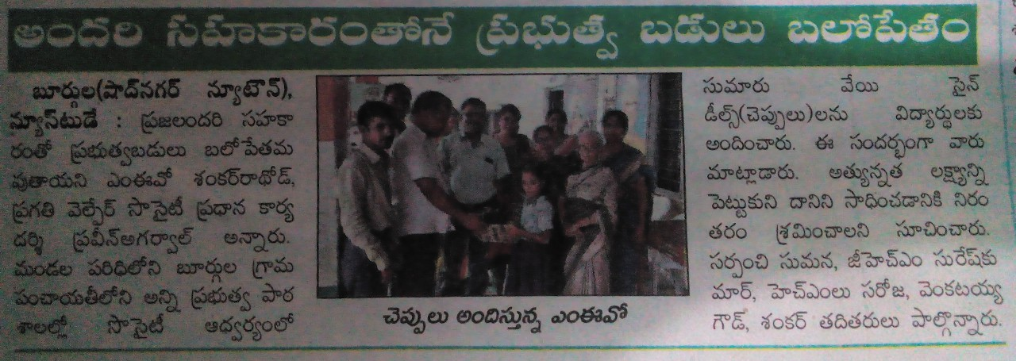
Shadnagar newtown – 15th June – 2016
Sandals Distribution in Govt schools

Slide 26
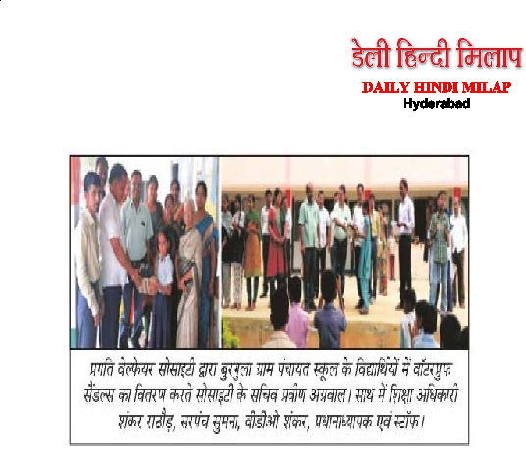
Hindi Milap 15th June – 2016
Sandals Distribution in Govt schools

Slide 27
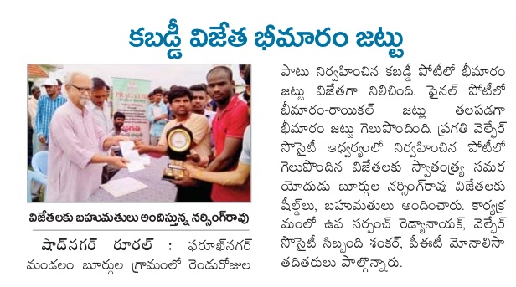
Shadnagar Rural : 10th October 2016
Pragathi Annual Youth Festival celebration

Slide 28
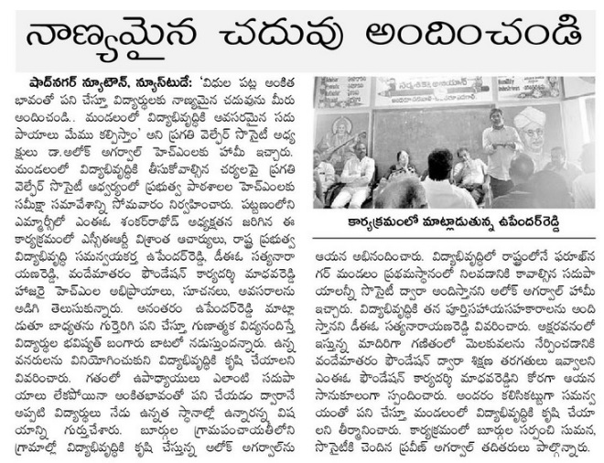
Shadnagar Newtown: November 29th – 2016
Education Improvement planning for Farooqnagar Mandal

Slide 29
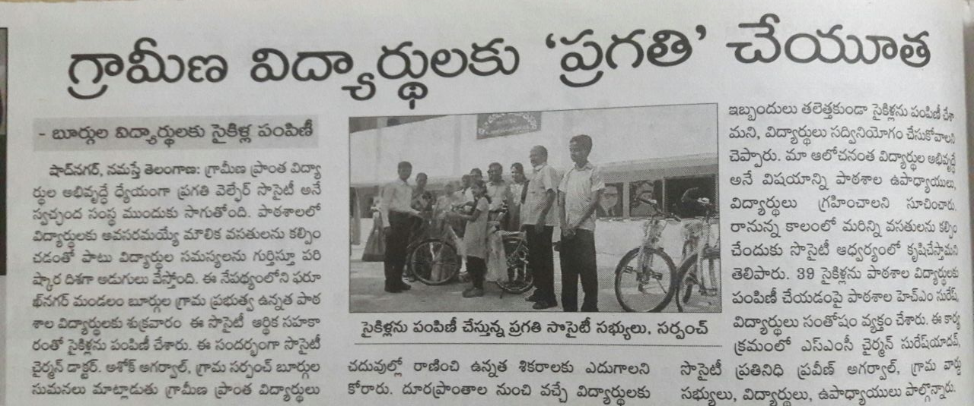
Namastay Telangana: 30th November – 2016
Distribution of 39 bycycles in Burgula Govt school

Slide 30
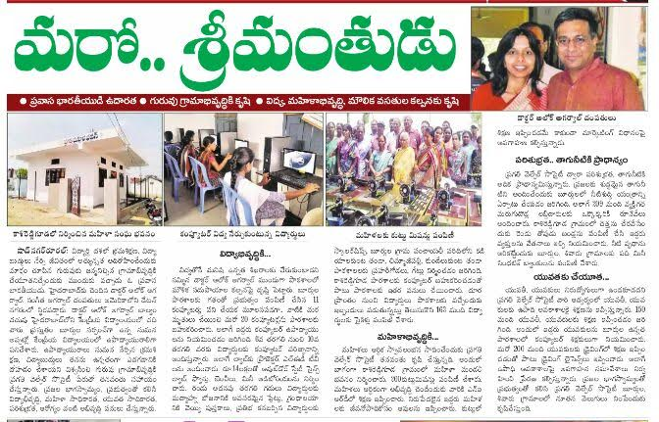
Shadnagar Rural : 17th December 2016
Pragathi Annual Youth Festival celebration

Slide 31
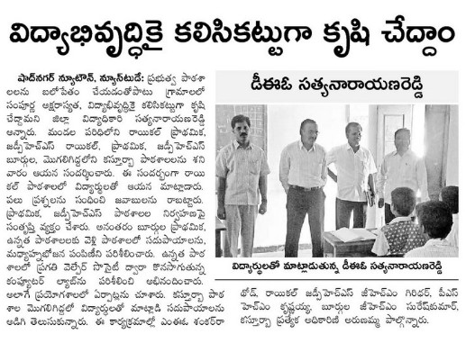
Shadnagar Newtown : November
Appreciation for Education Improvement projects

Slide 32
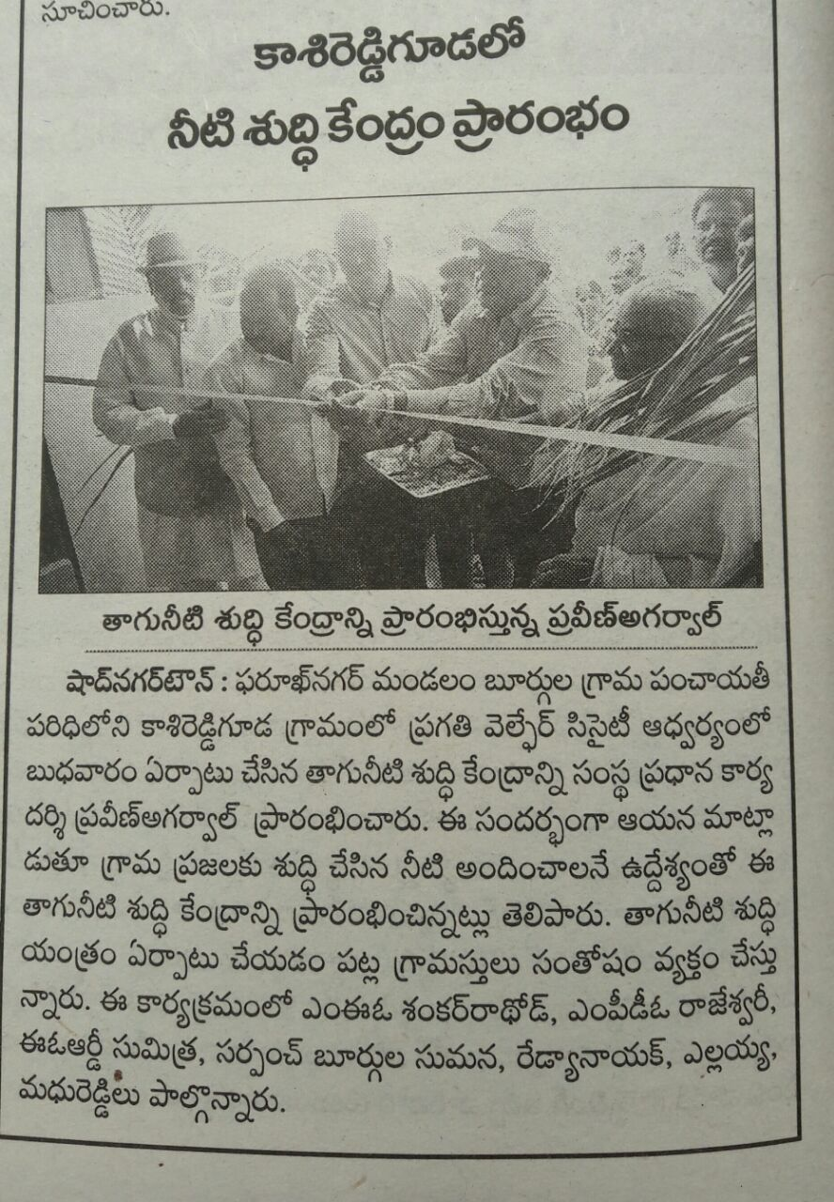
Shadnagar New Town:March 15th – 2017
Water Treatment Plant Inaugurationat Kashireddyguda

Slide 33
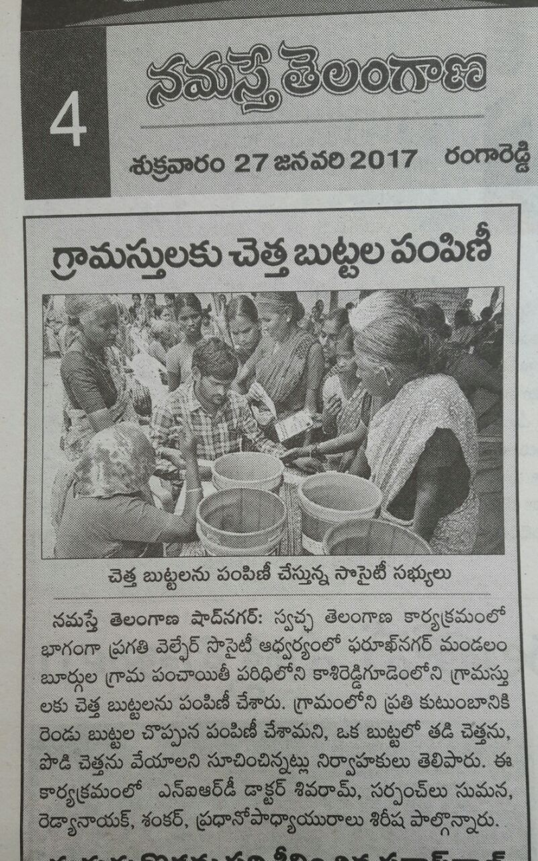
Namastay Telangana:27th January – 2017
Distribution of dustbins for waste segregation project

